Slide 1

How I Built Elevators
and Feed Mills
on the Kansas Division
of the Rock Island
Part II
Concrete Country Elevators and Mills
of 1940’s … 50’s … and 60’s
by Ken Jenkins

Slide 2
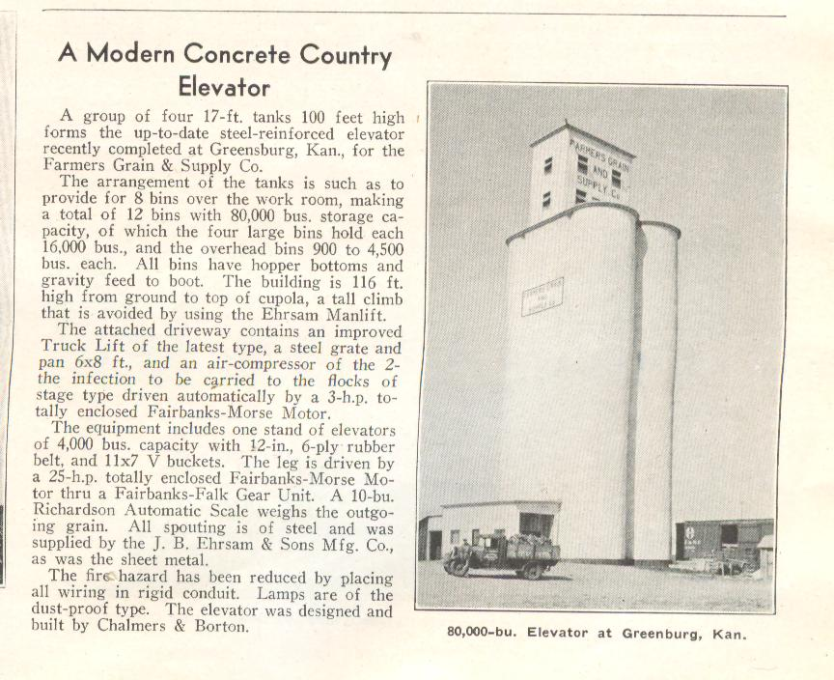
1940’s era … Typical
Modern Concrete Country Elevator
116’ Height
80,000 bu
4 tanks 17’Ø x 100’ = 16,000 bu
16’ Cupola
Truck incoming … RR outgoing
17’ Ø x 100’

Slide 3
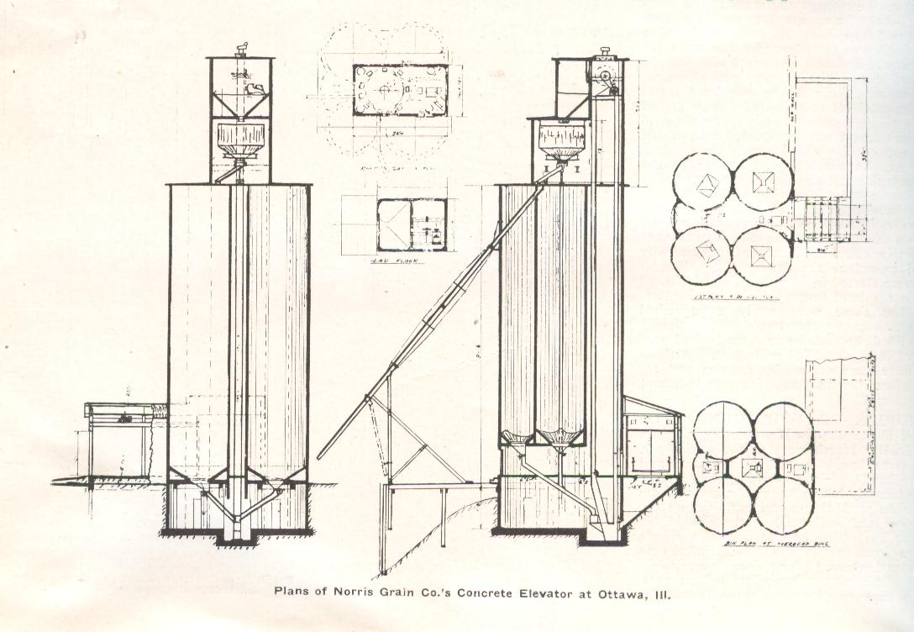
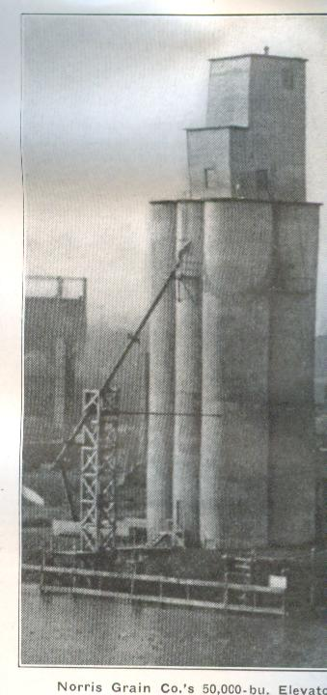
vertical
legs
Tanks
delivery
tube
unloading
loading
50,000 bu Elevator

Slide 4
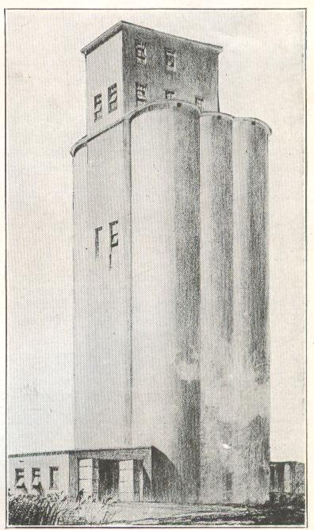
Head House …
16’ to 35’ high
Typical Silos
vary in size …
17’ Ø to 30’ diameter
80’ to 120’ high
Type of Concrete Elevator Built at Several
Kansas Stations

Slide 5
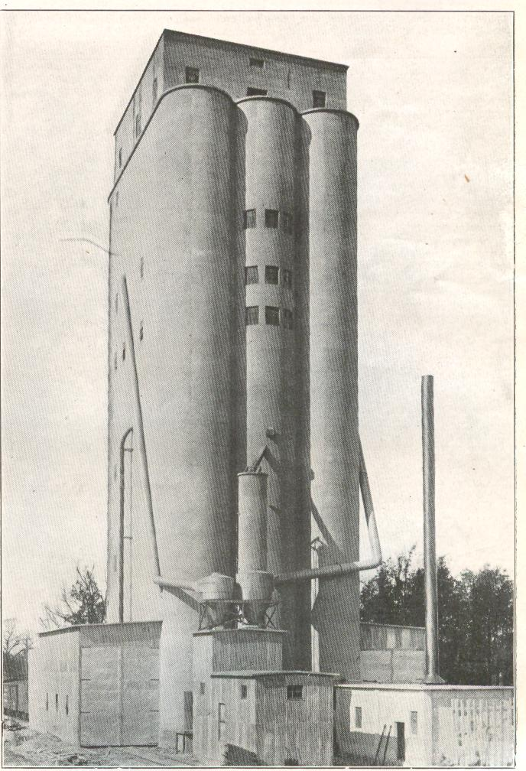

Slide 6
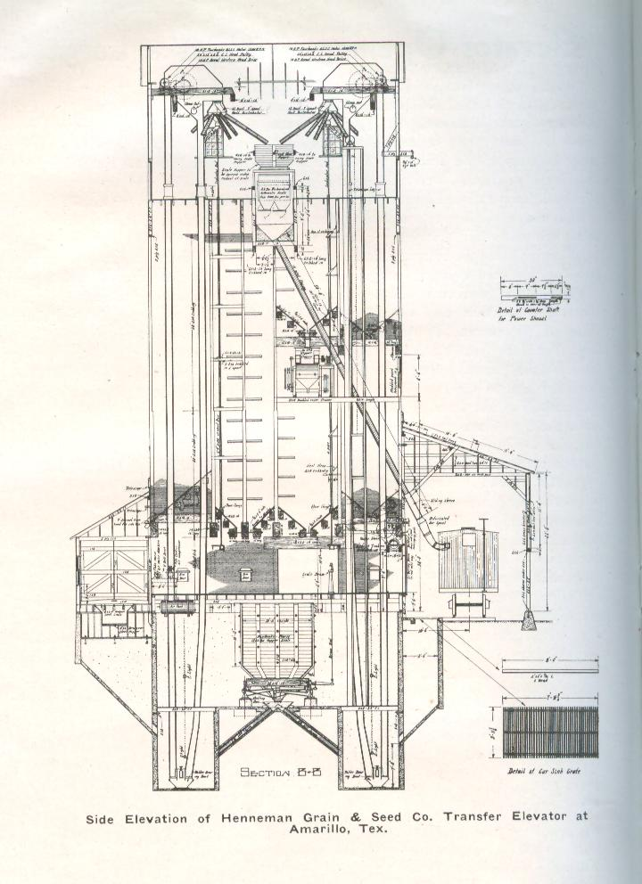
mixing
vertical leg
bucket hoists
delivery tube
RR loading
Truck
Delivery …
Unloading

Slide 7
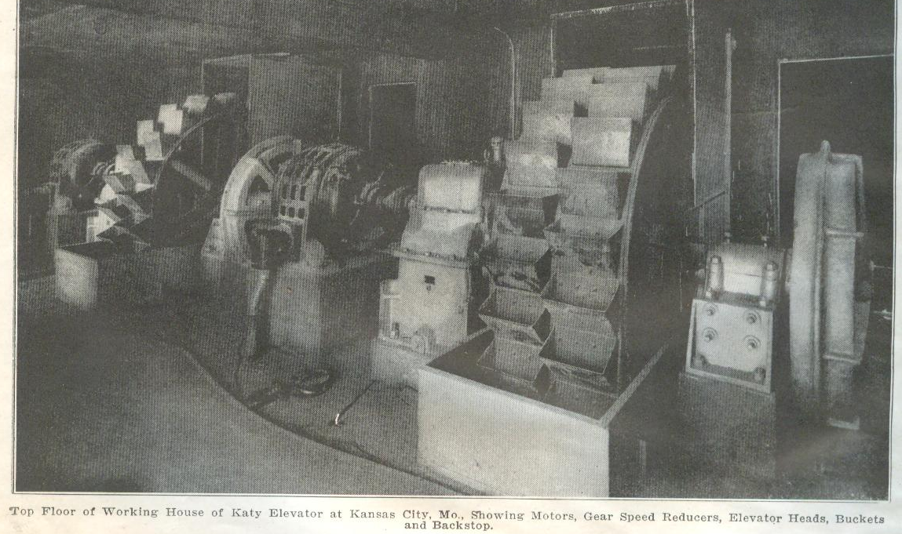
Electric Motor Drive
Grain Bucket Hoist
Sheave Bearings
Working House … Vertical Bucket Hoisting

Slide 8
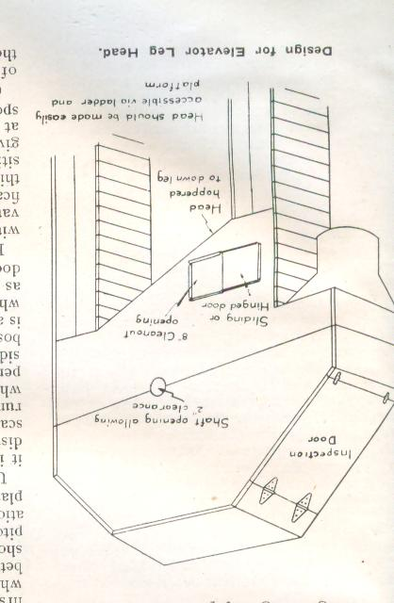
Design for Elevator Leg Head

Slide 9
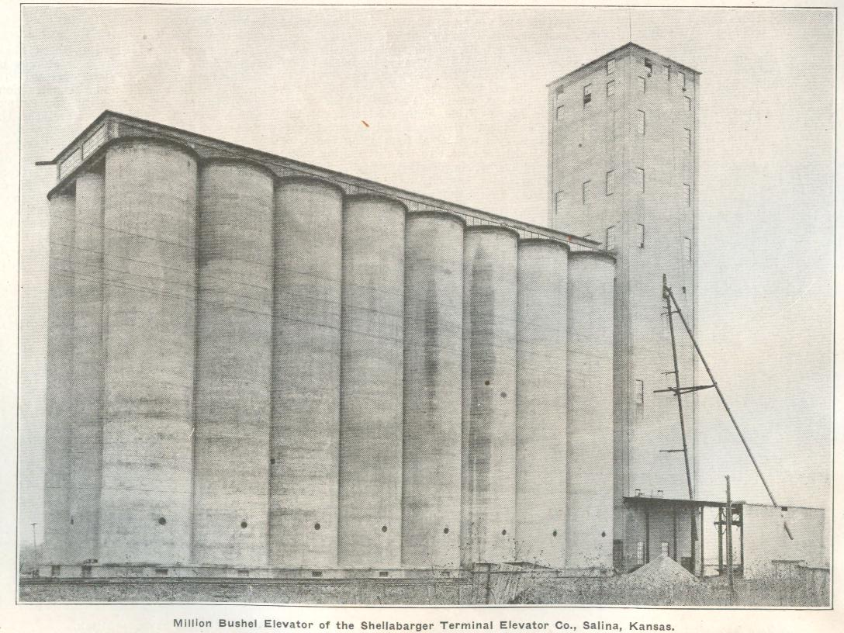
One Million Bushel
22’ Ø x 110’ high
Shellabarger Terminal Elevator
Salina, Kansas

Slide 10
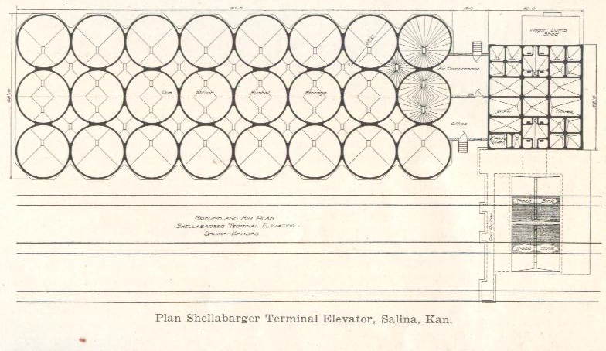
183’-0”
15’-0”
40’-0”
68’-0”
44’-0”
Shellabarger Terminal Elevator
Salina, Kansas

Slide 11
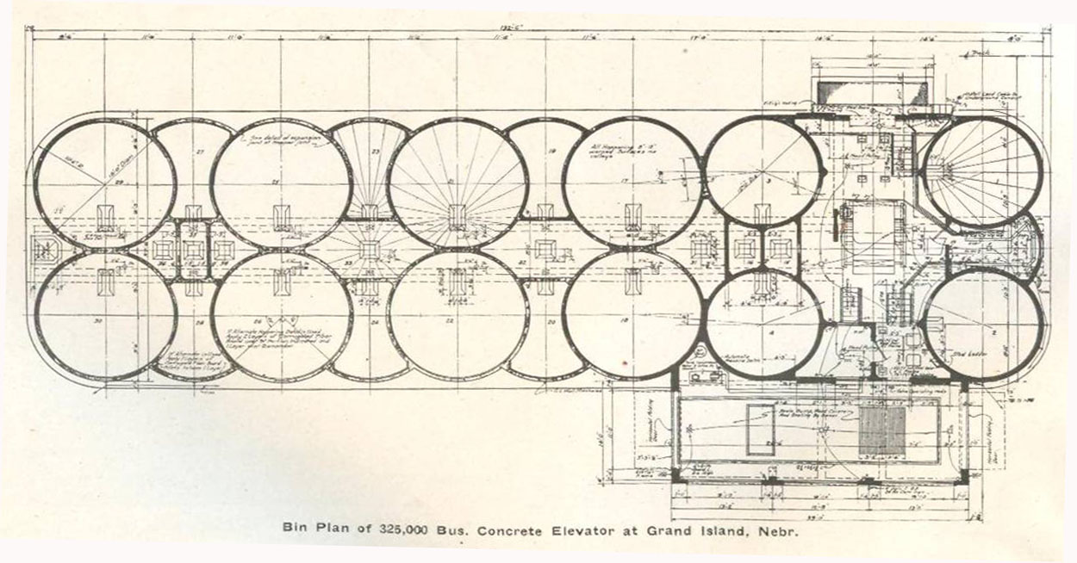
Main Round Bins
Interstice Storage Bins
Example of Interstice Bins

Slide 12
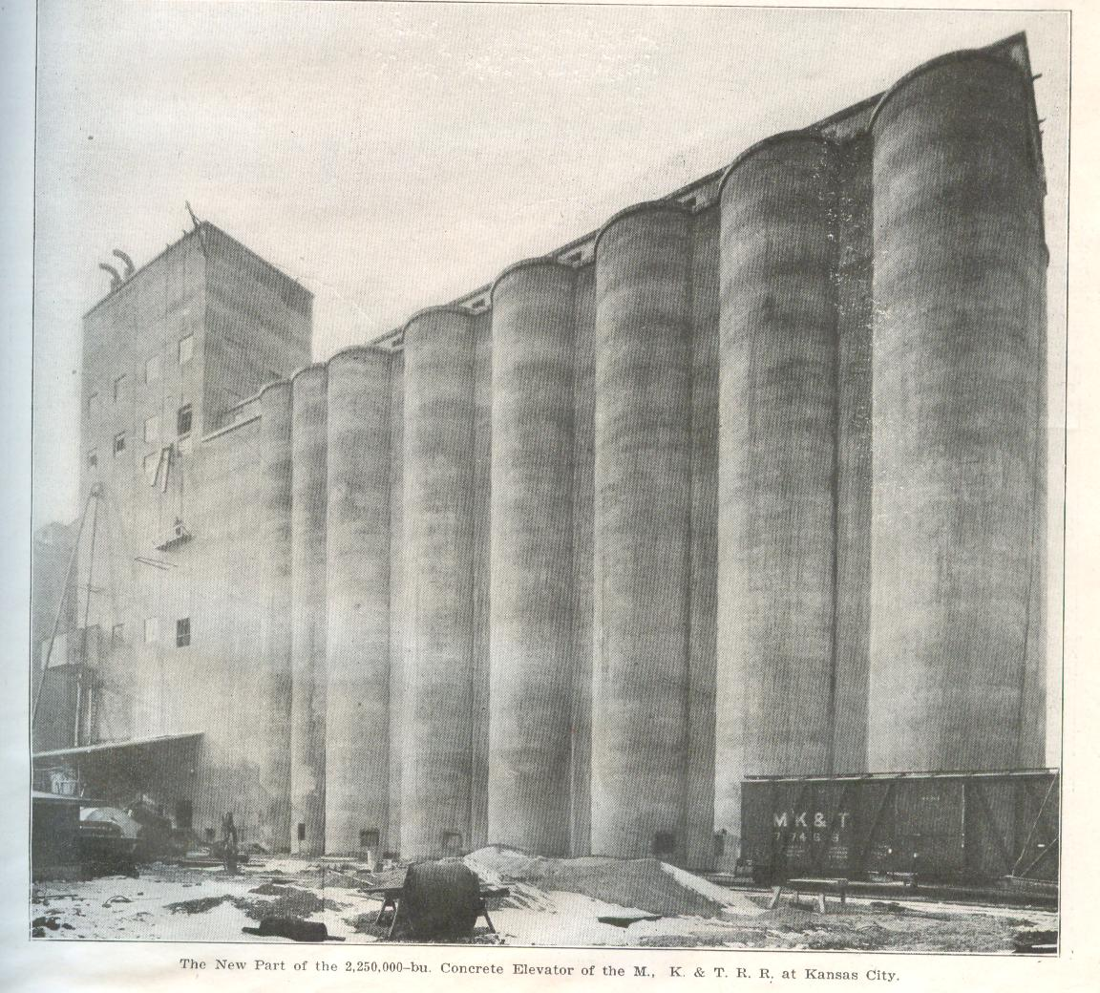
2,250,000 bushel
Tanks
23’ Ø x 115’ tall
Katy Elevator
Kansas City, KS … Rosedale

Slide 13
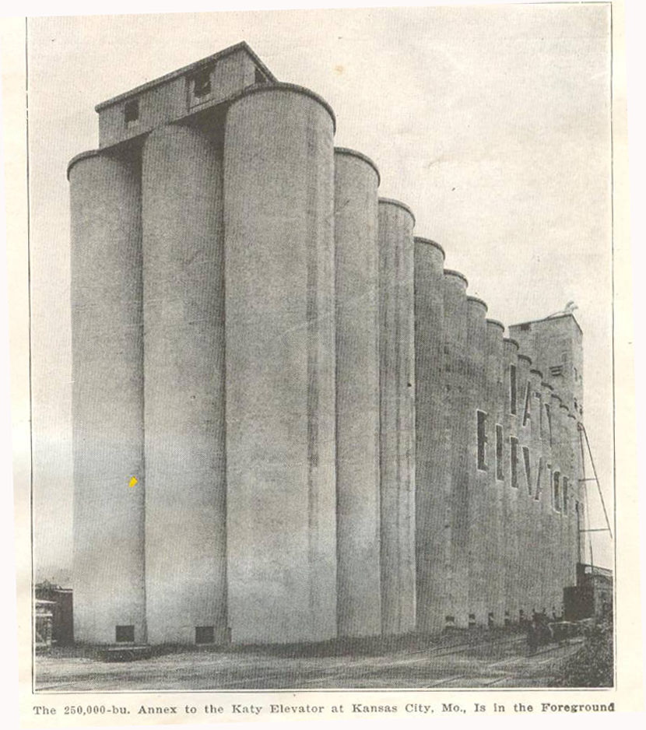
250,000 Annex
Katy Elevator
Kansas City

Slide 14
Construction Process …
Construction Process …

Slide 15
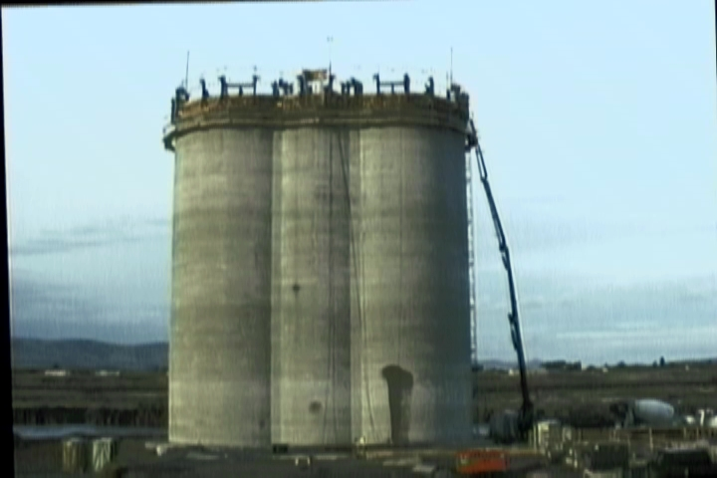
“Slip Form” Construction Process

Slide 16
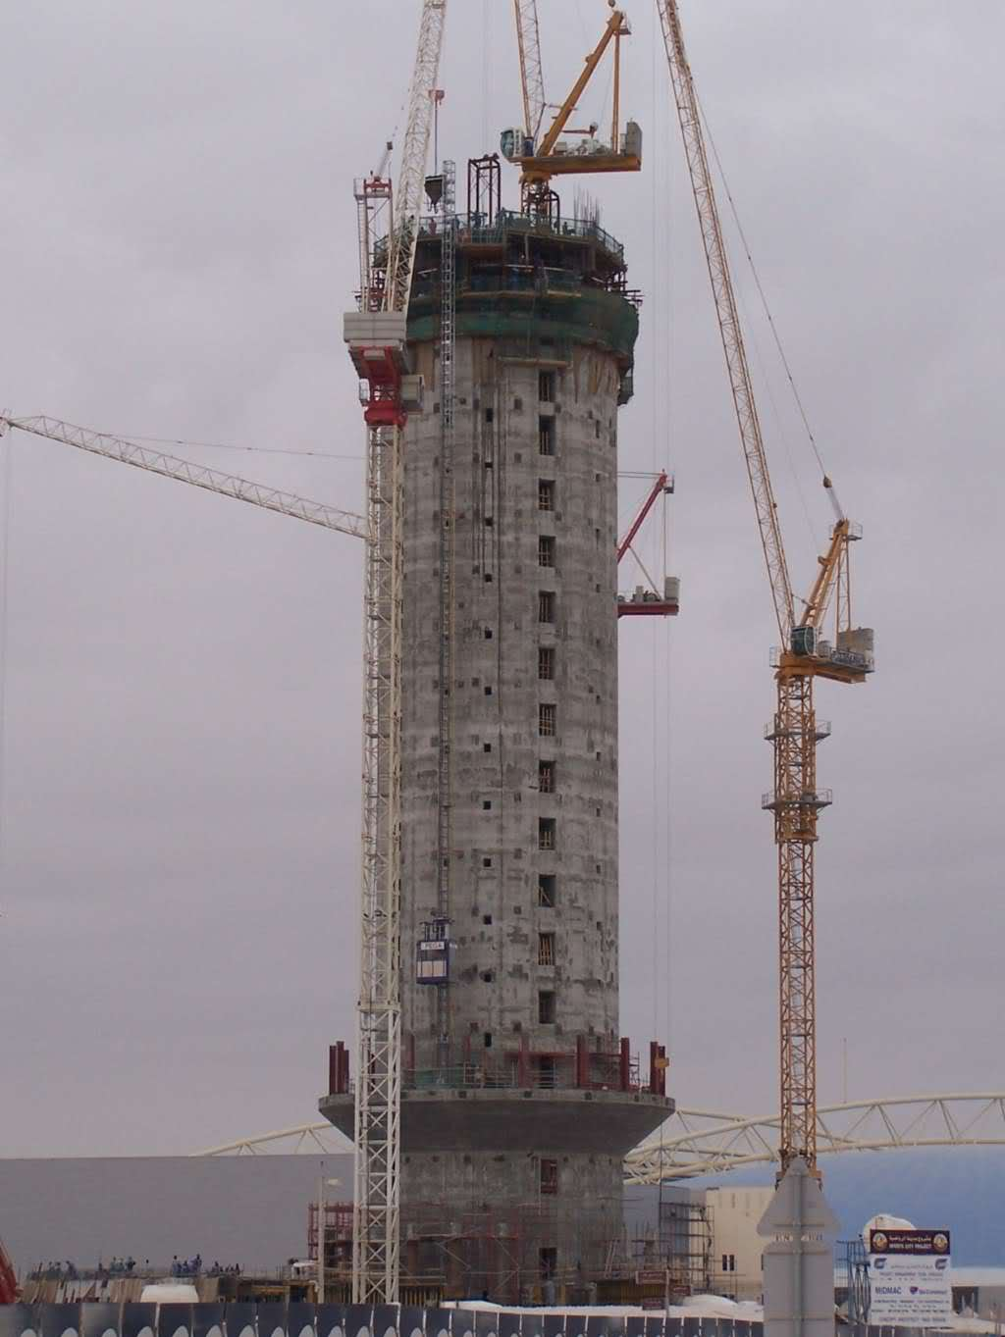
“Slip Form” Construction Process

Slide 17
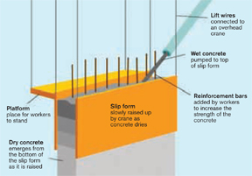
“Slip Form” Construction Process

Slide 18
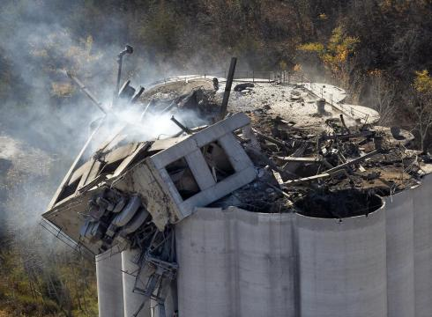
Grain Dust Explosion
Atchison, Kansas 2011

Slide 19
Prototype Practice
Prototype Practice
Loading & Unloading

Slide 20
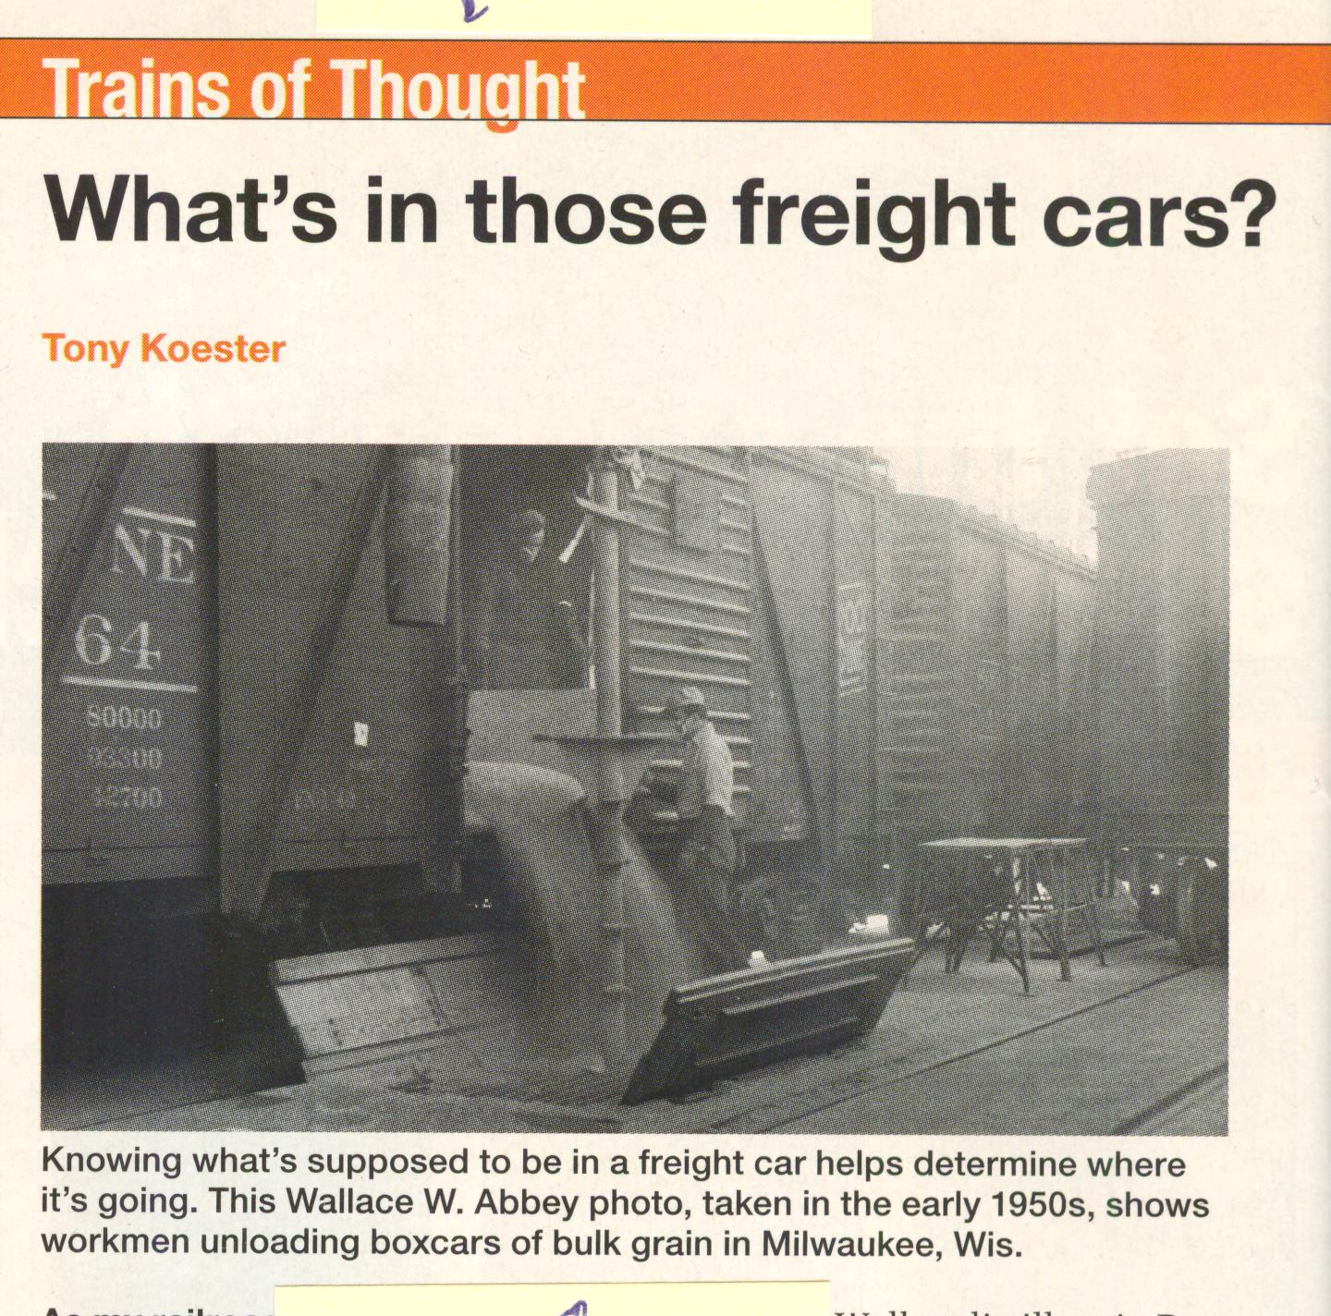
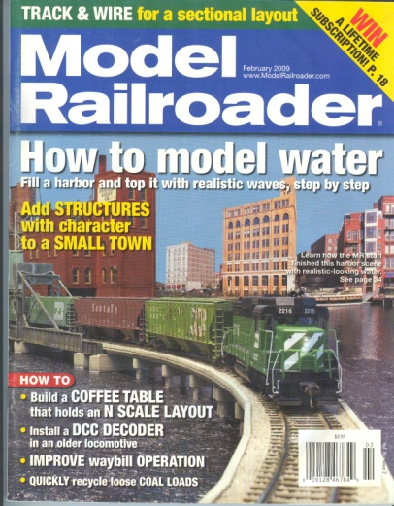

Slide 21
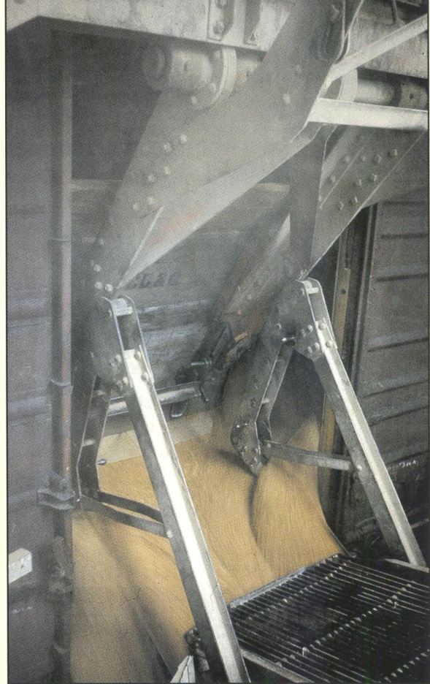
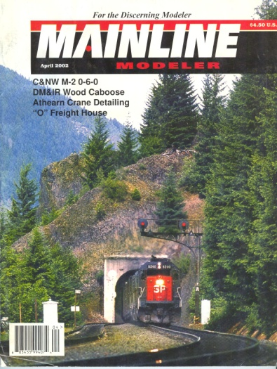

Slide 22
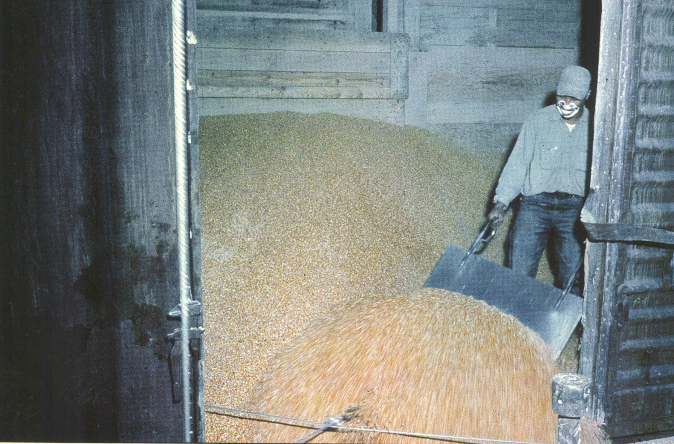

Slide 23
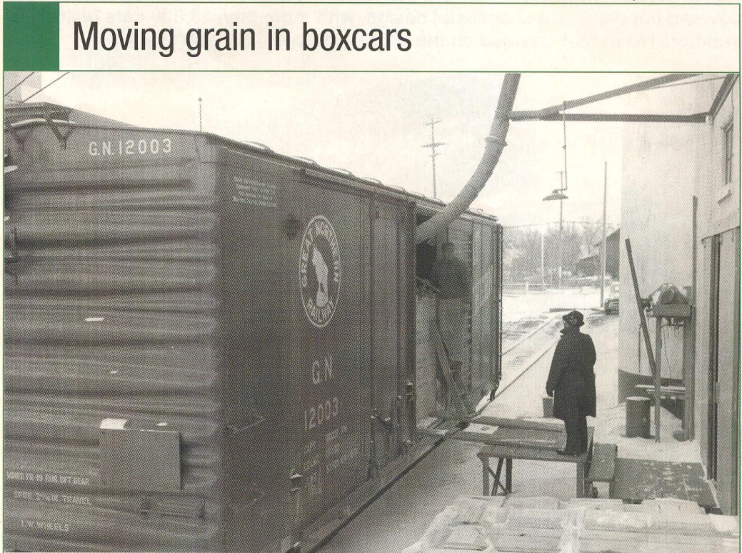

Slide 24
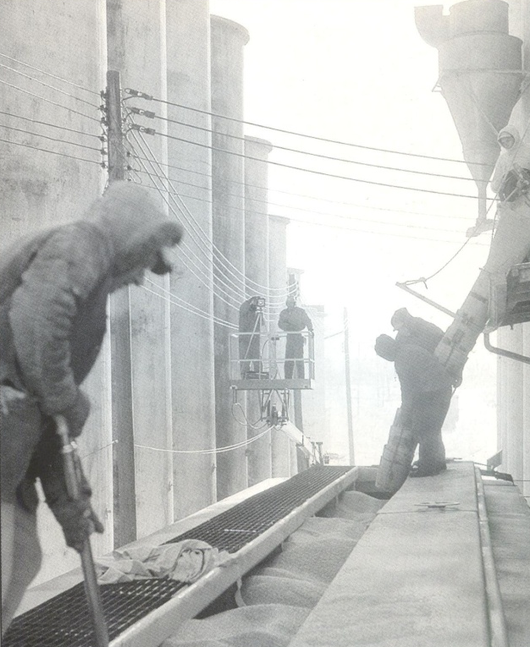

Slide 25
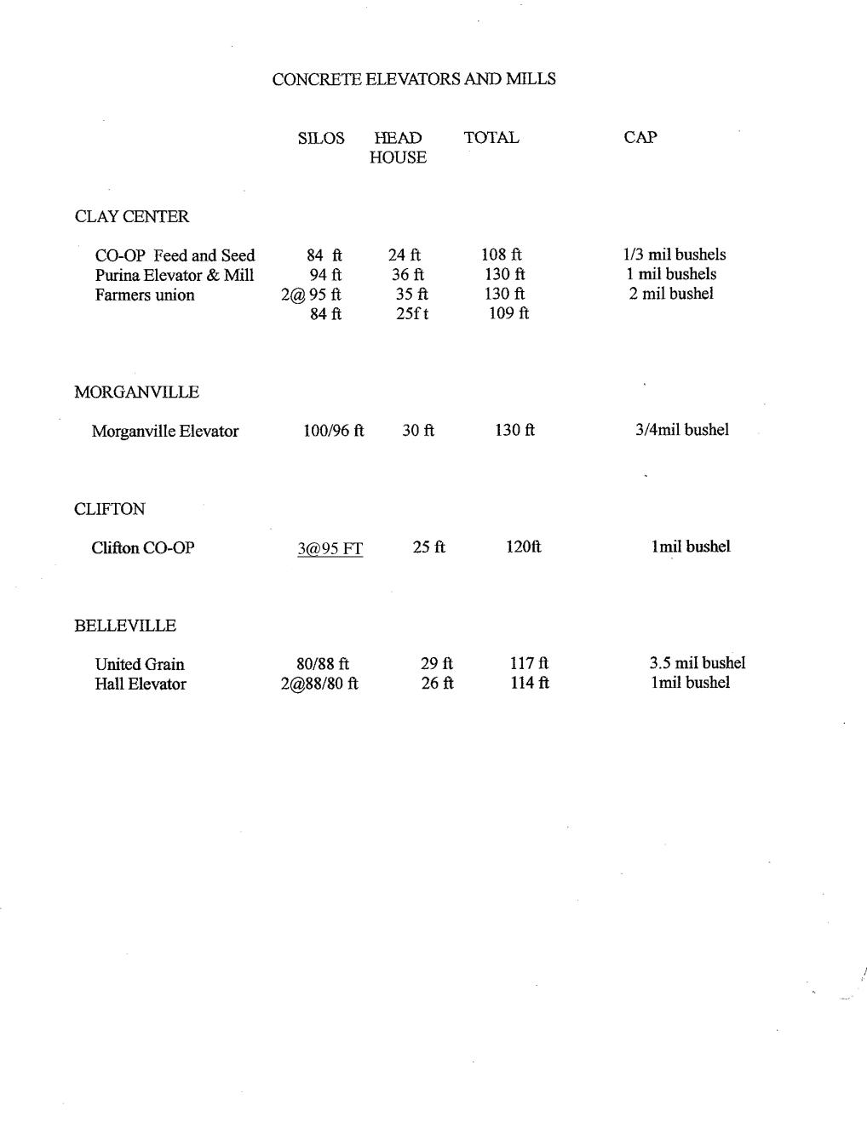
Layout Photos
Layout Photos

Slide 26
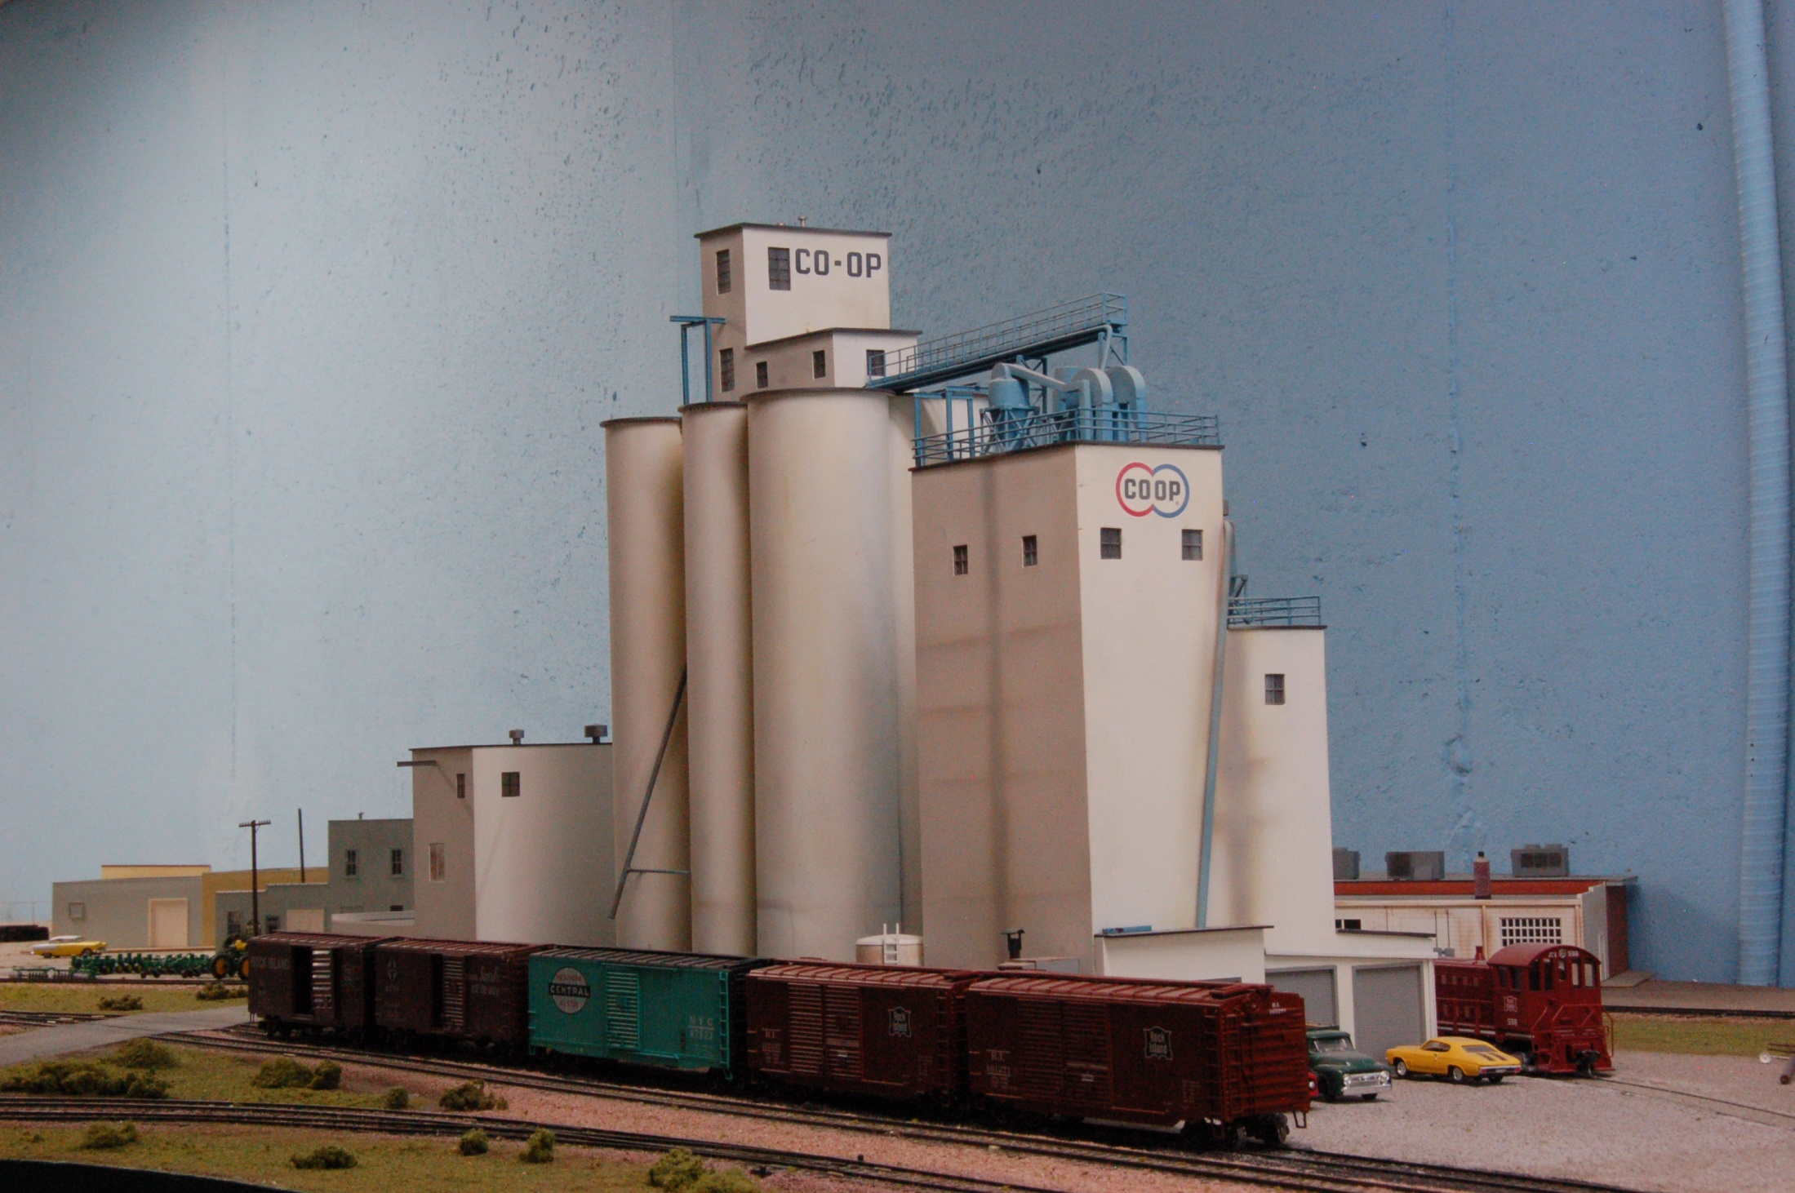
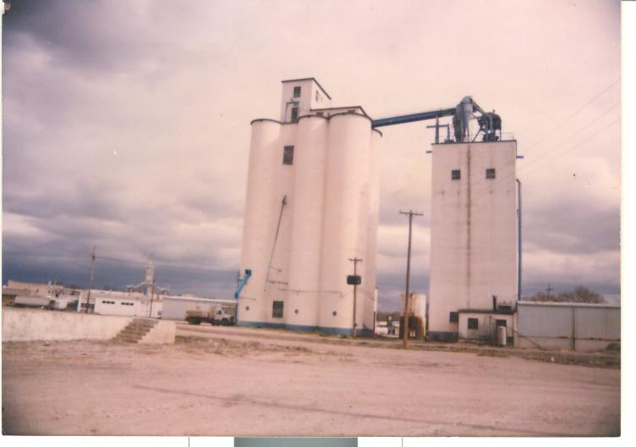
1/3 Million Bushel Capacity
24’ Head House
“Prototype”
84’ silos
CO-OP Feed & Seed
Clay Center, Kansas

Slide 27
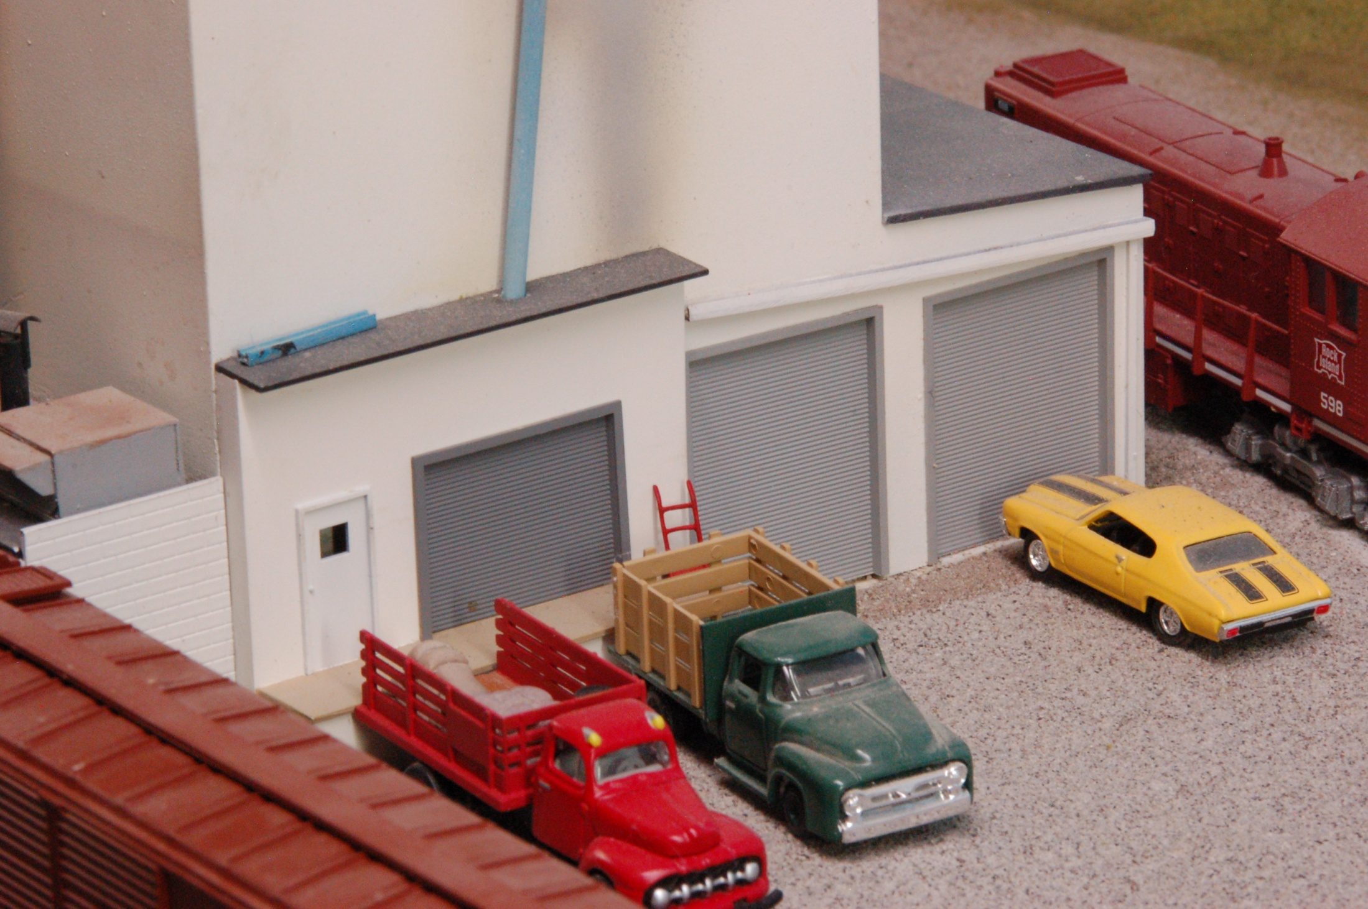
CO-OP Feed & Seed
Clay Center, Kansas

Slide 28
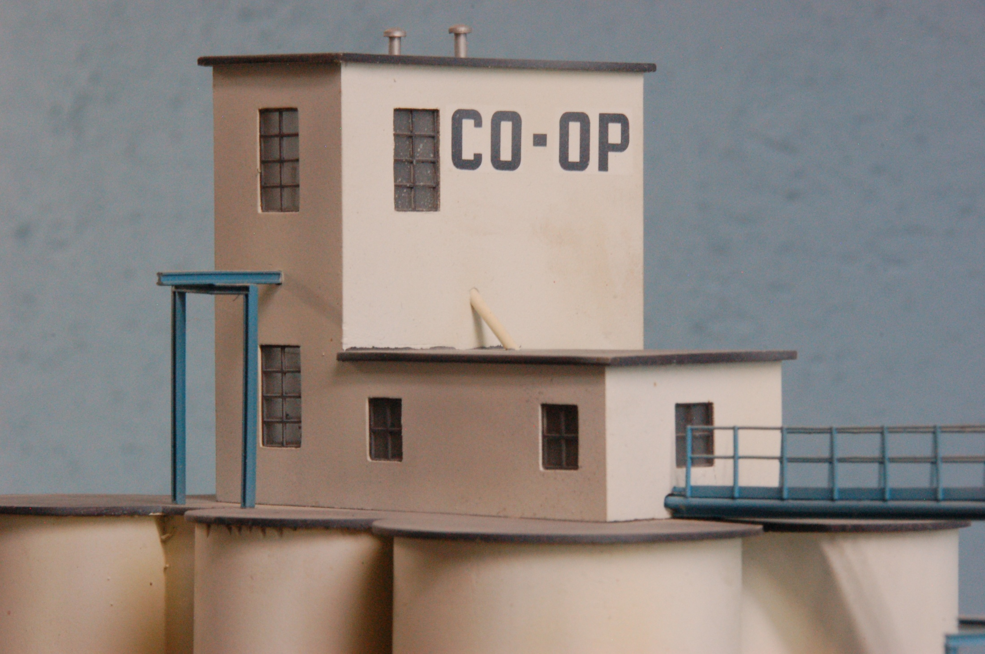
CO-OP Feed & Seed
Clay Center, Kansas

Slide 29
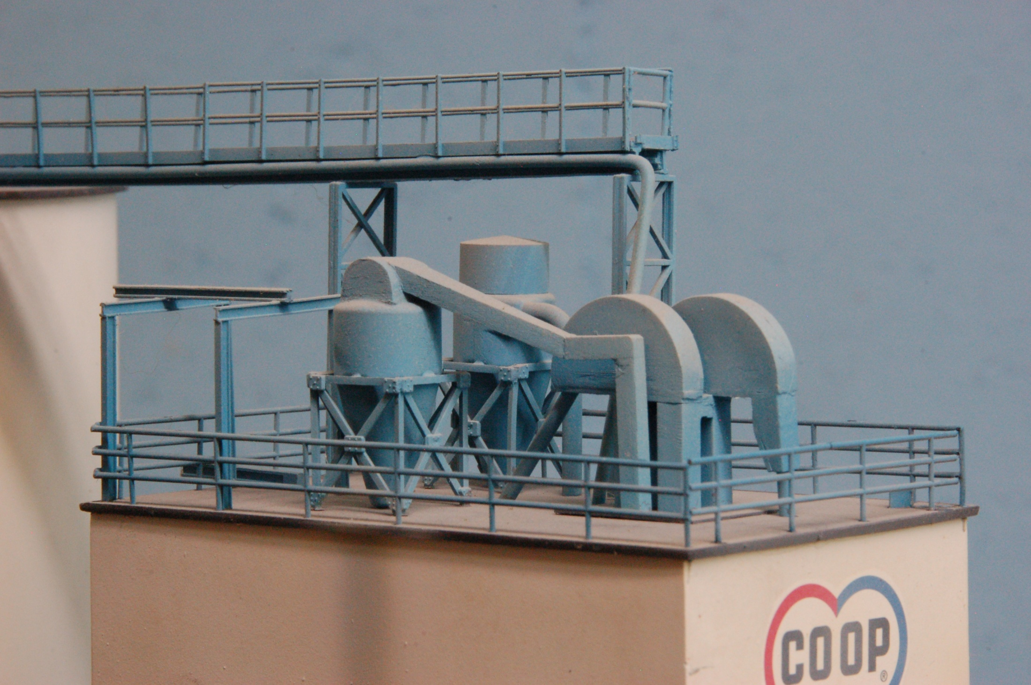
CO-OP Feed & Seed
Clay Center, Kansas

Slide 30
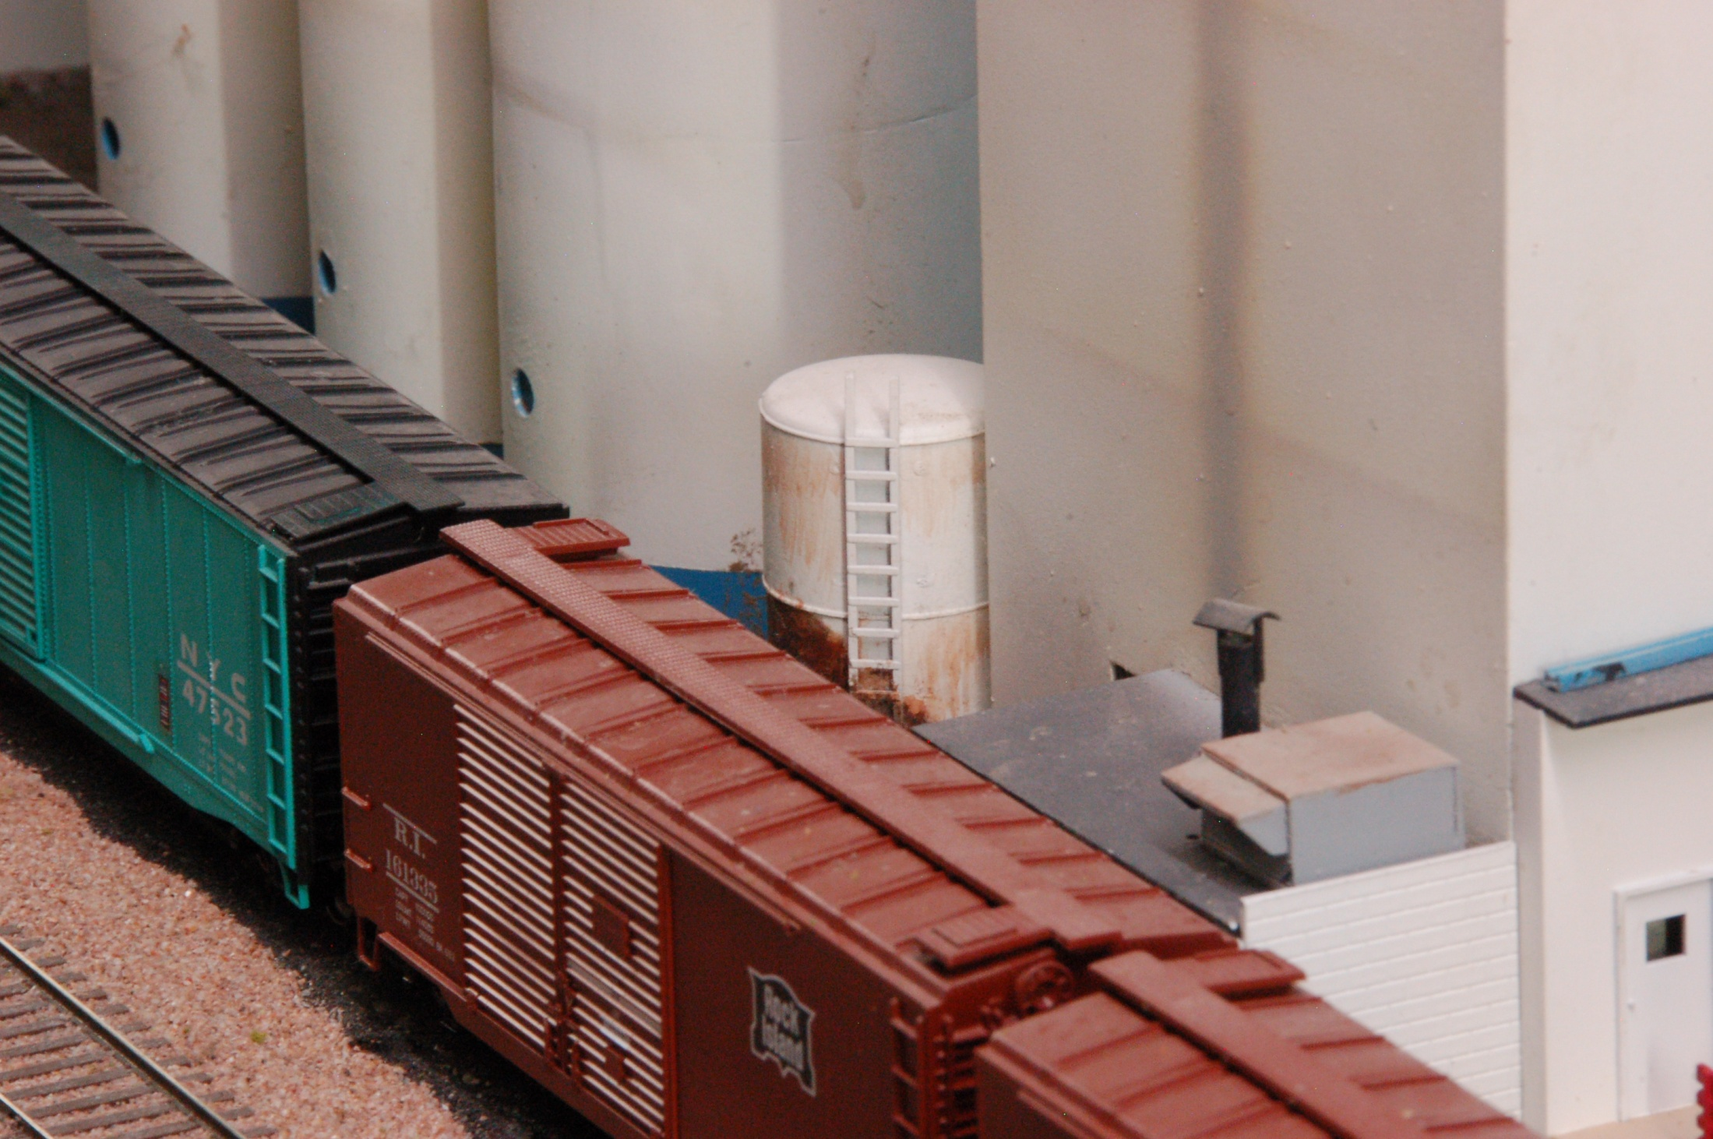
CO-OP Feed & Seed
Clay Center, Kansas

Slide 31
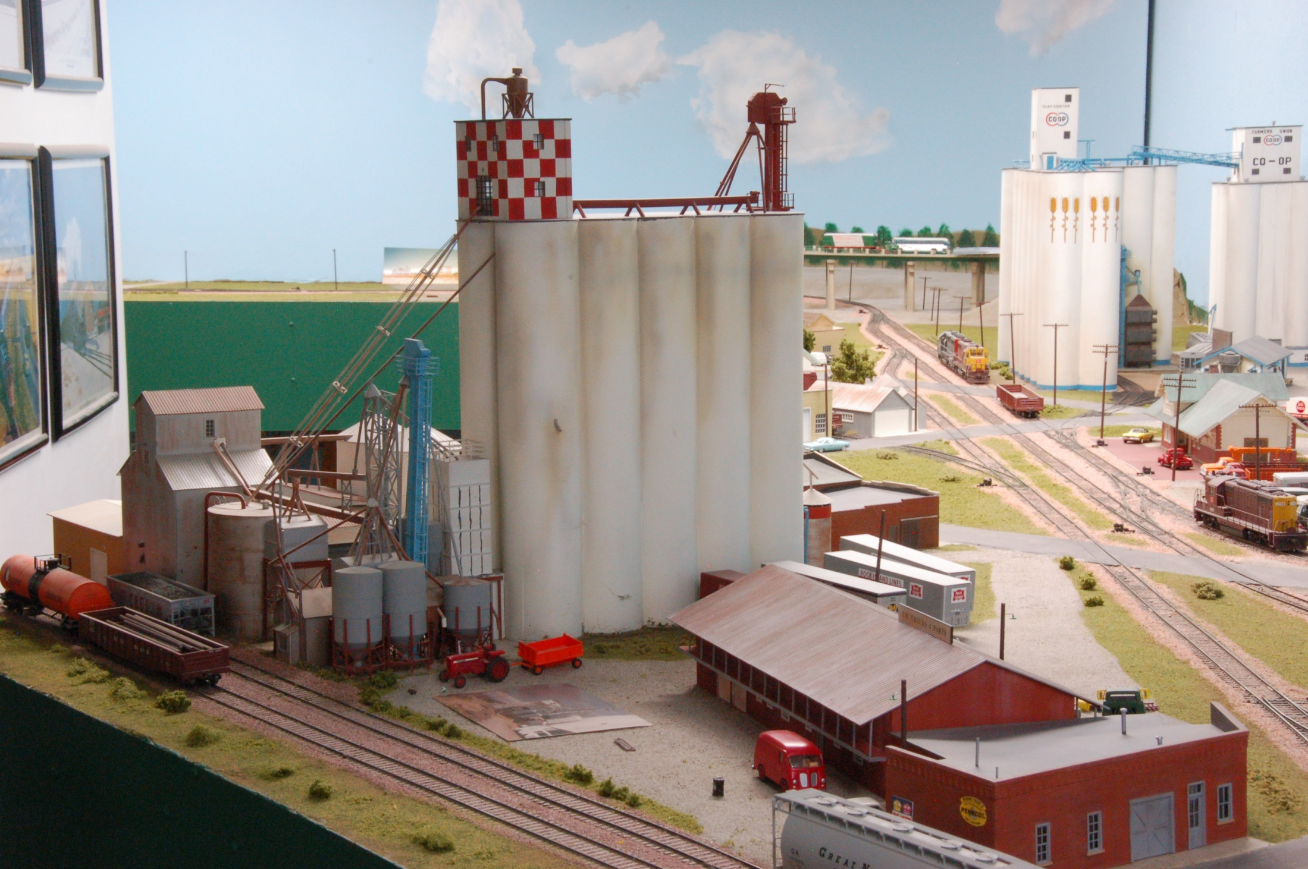
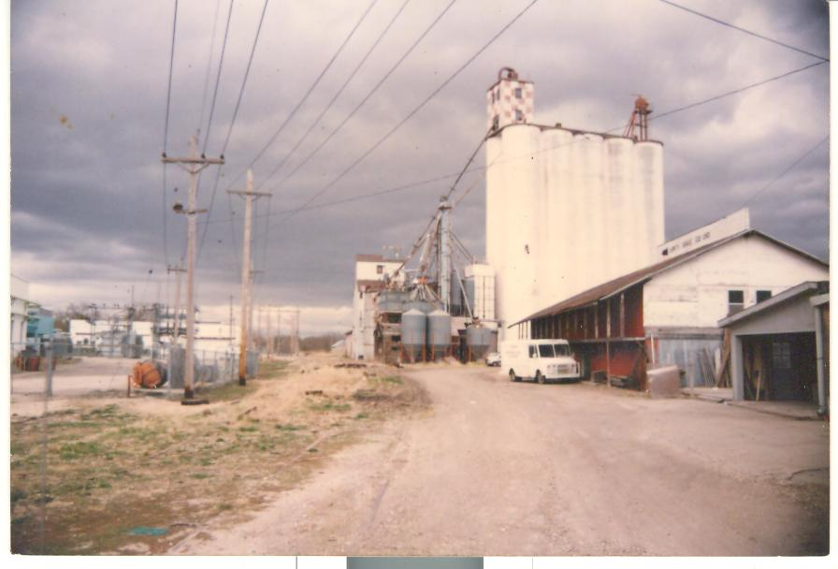
1 million bushel capacity
36’ Head House
“Prototype”
94’silos
Purina Elevator & Mill
Clay Center, Kansas

Slide 32
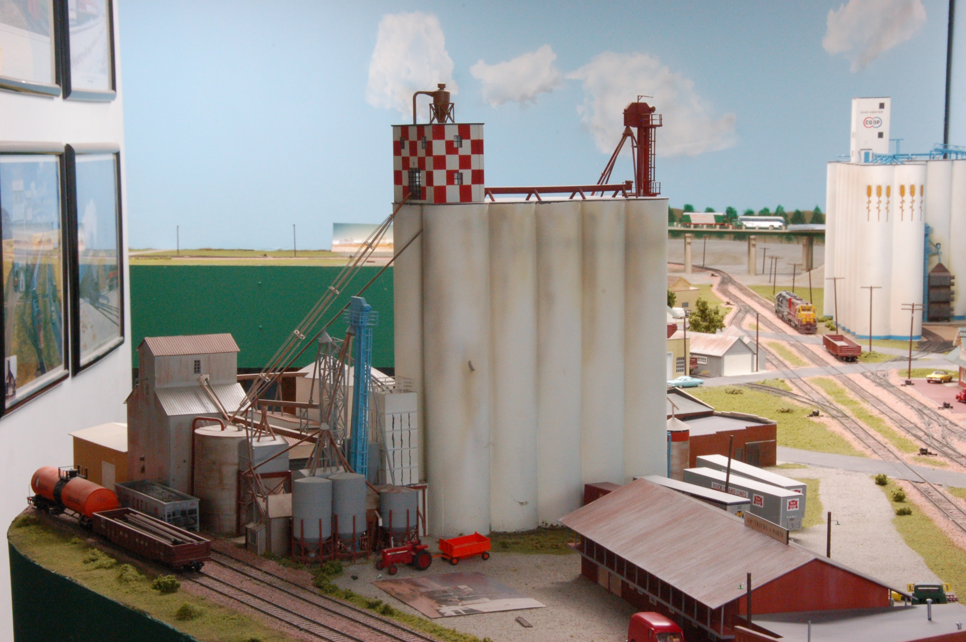
Purina Elevator & Mill
Clay Center, Kansas

Slide 33
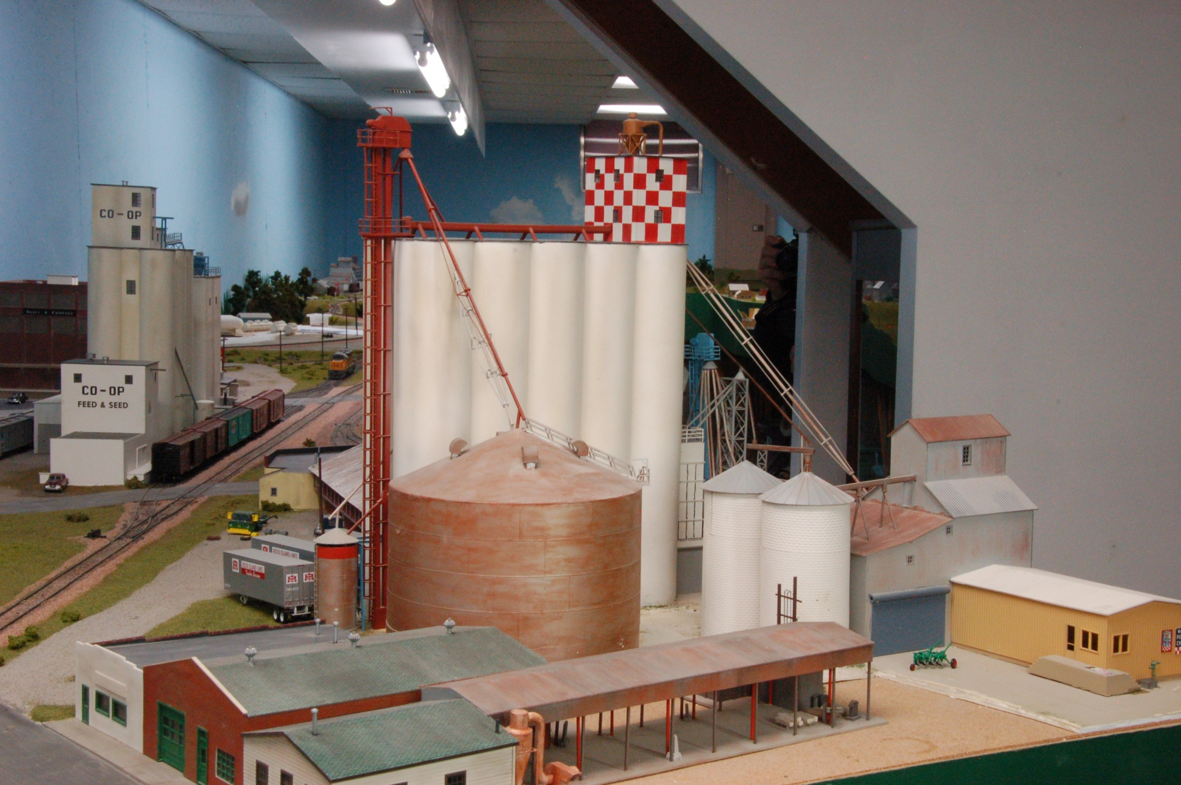
Purina Elevator & Mill
Clay Center, Kansas
33

Slide 34
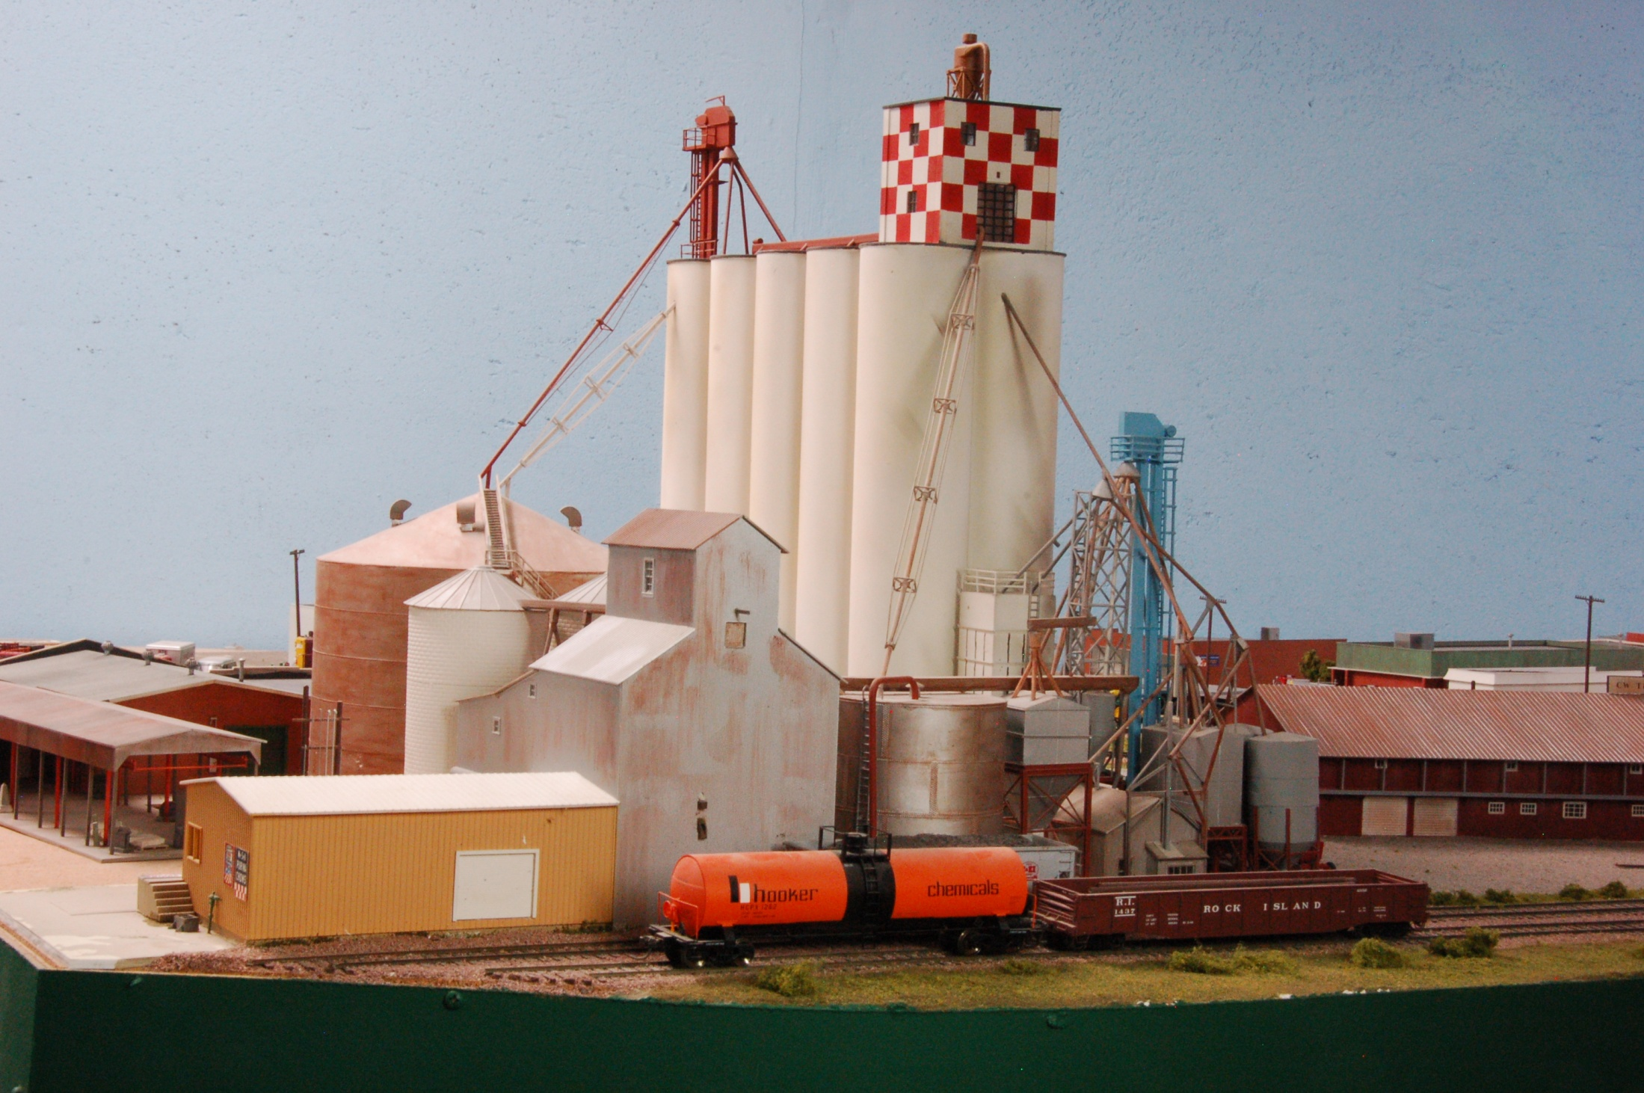
Purina Elevator & Mill
Clay Center, Kansas

Slide 35
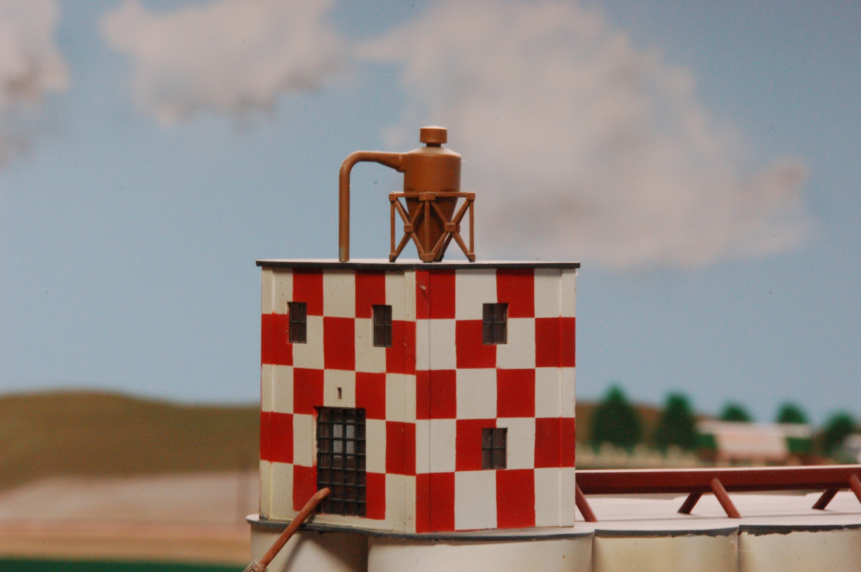
Purina Elevator & Mill
Clay Center, Kansas

Slide 36
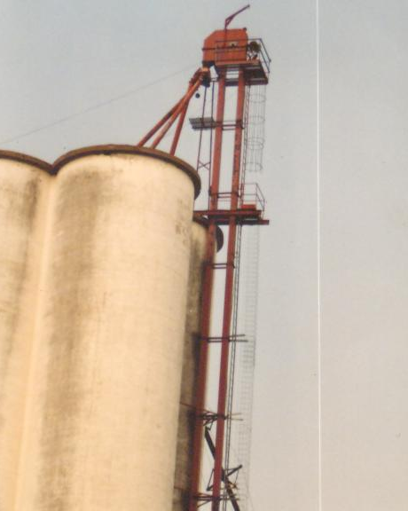
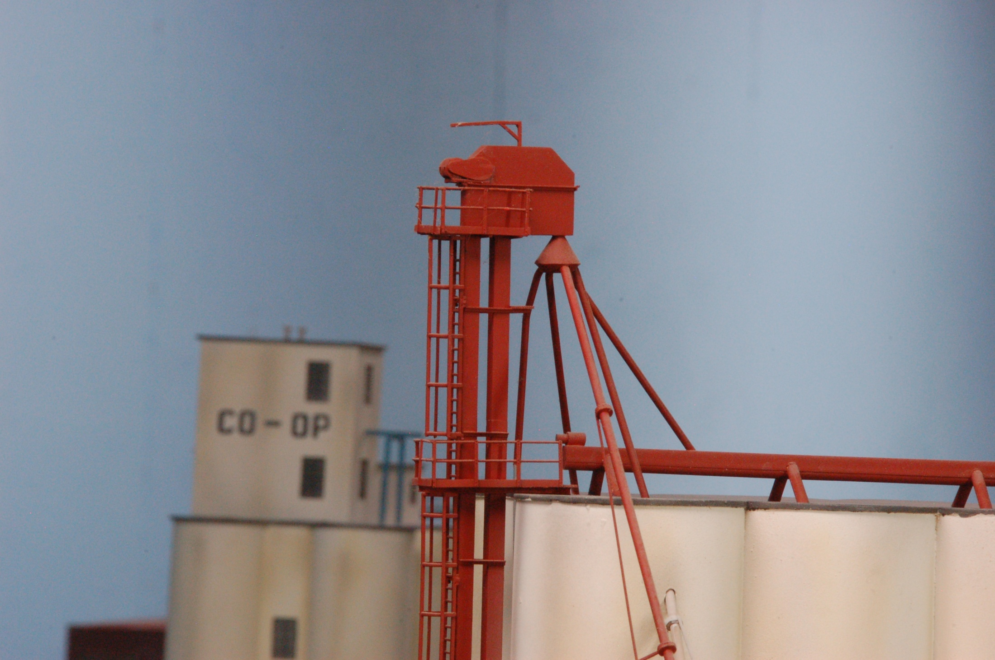
“Prototype”
Purina Elevator & Mill
Clay Center, Kansas

Slide 37
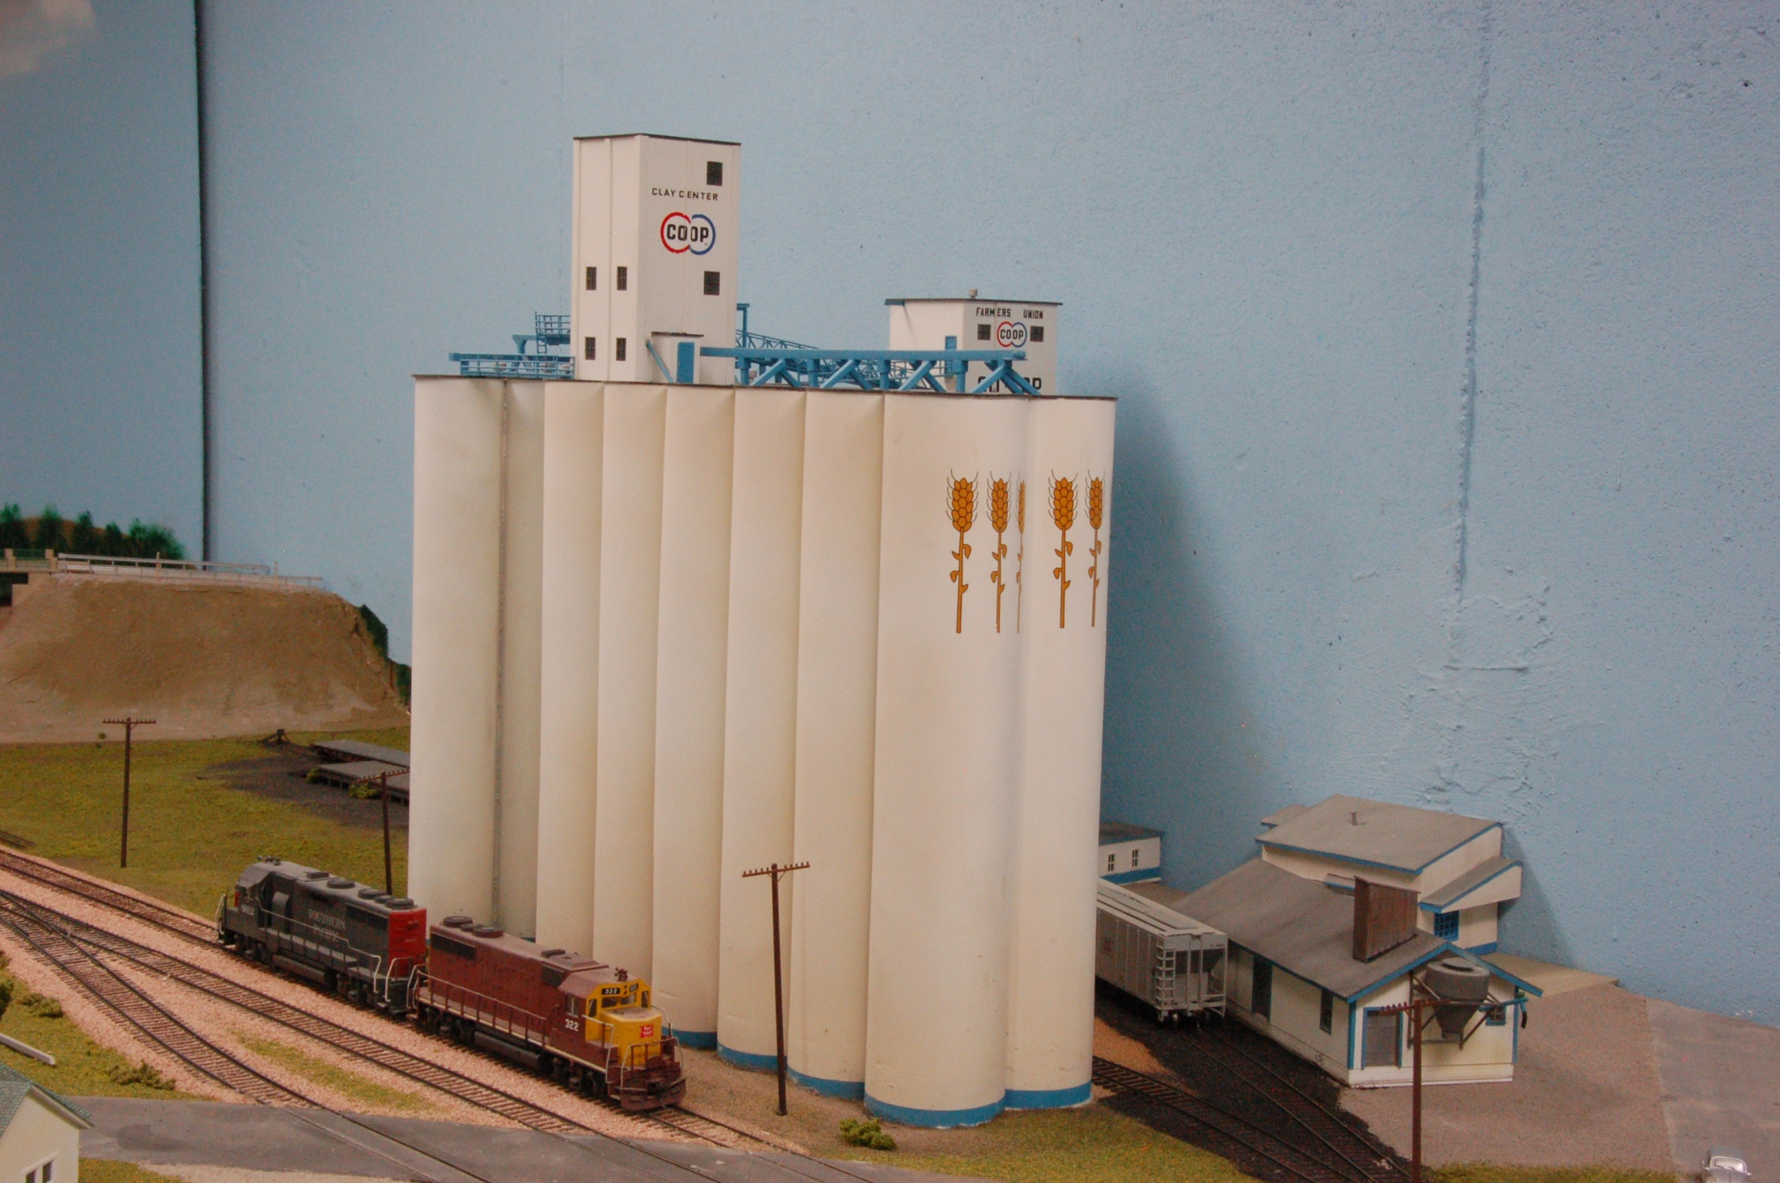
2 Million Bushel Capacity
35’ Head house
(behind)
25’ head house
Silos 2@95’
Farmers Union CO-OP
Clay Center, Kansas

Slide 38
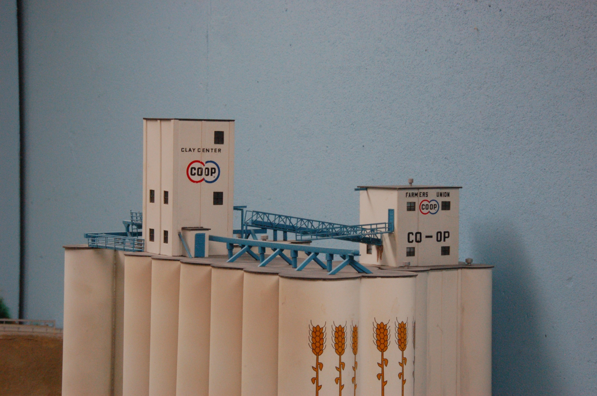
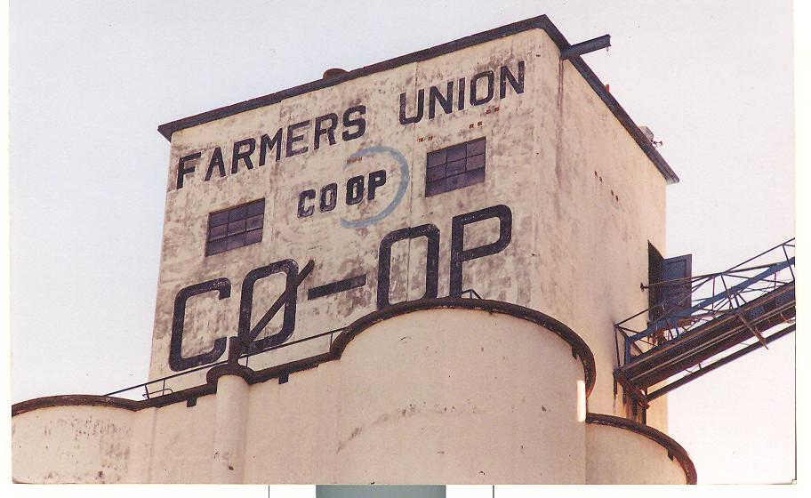
“Prototype”
Farmers Union CO-OP
Clay Center, Kansas

Slide 39
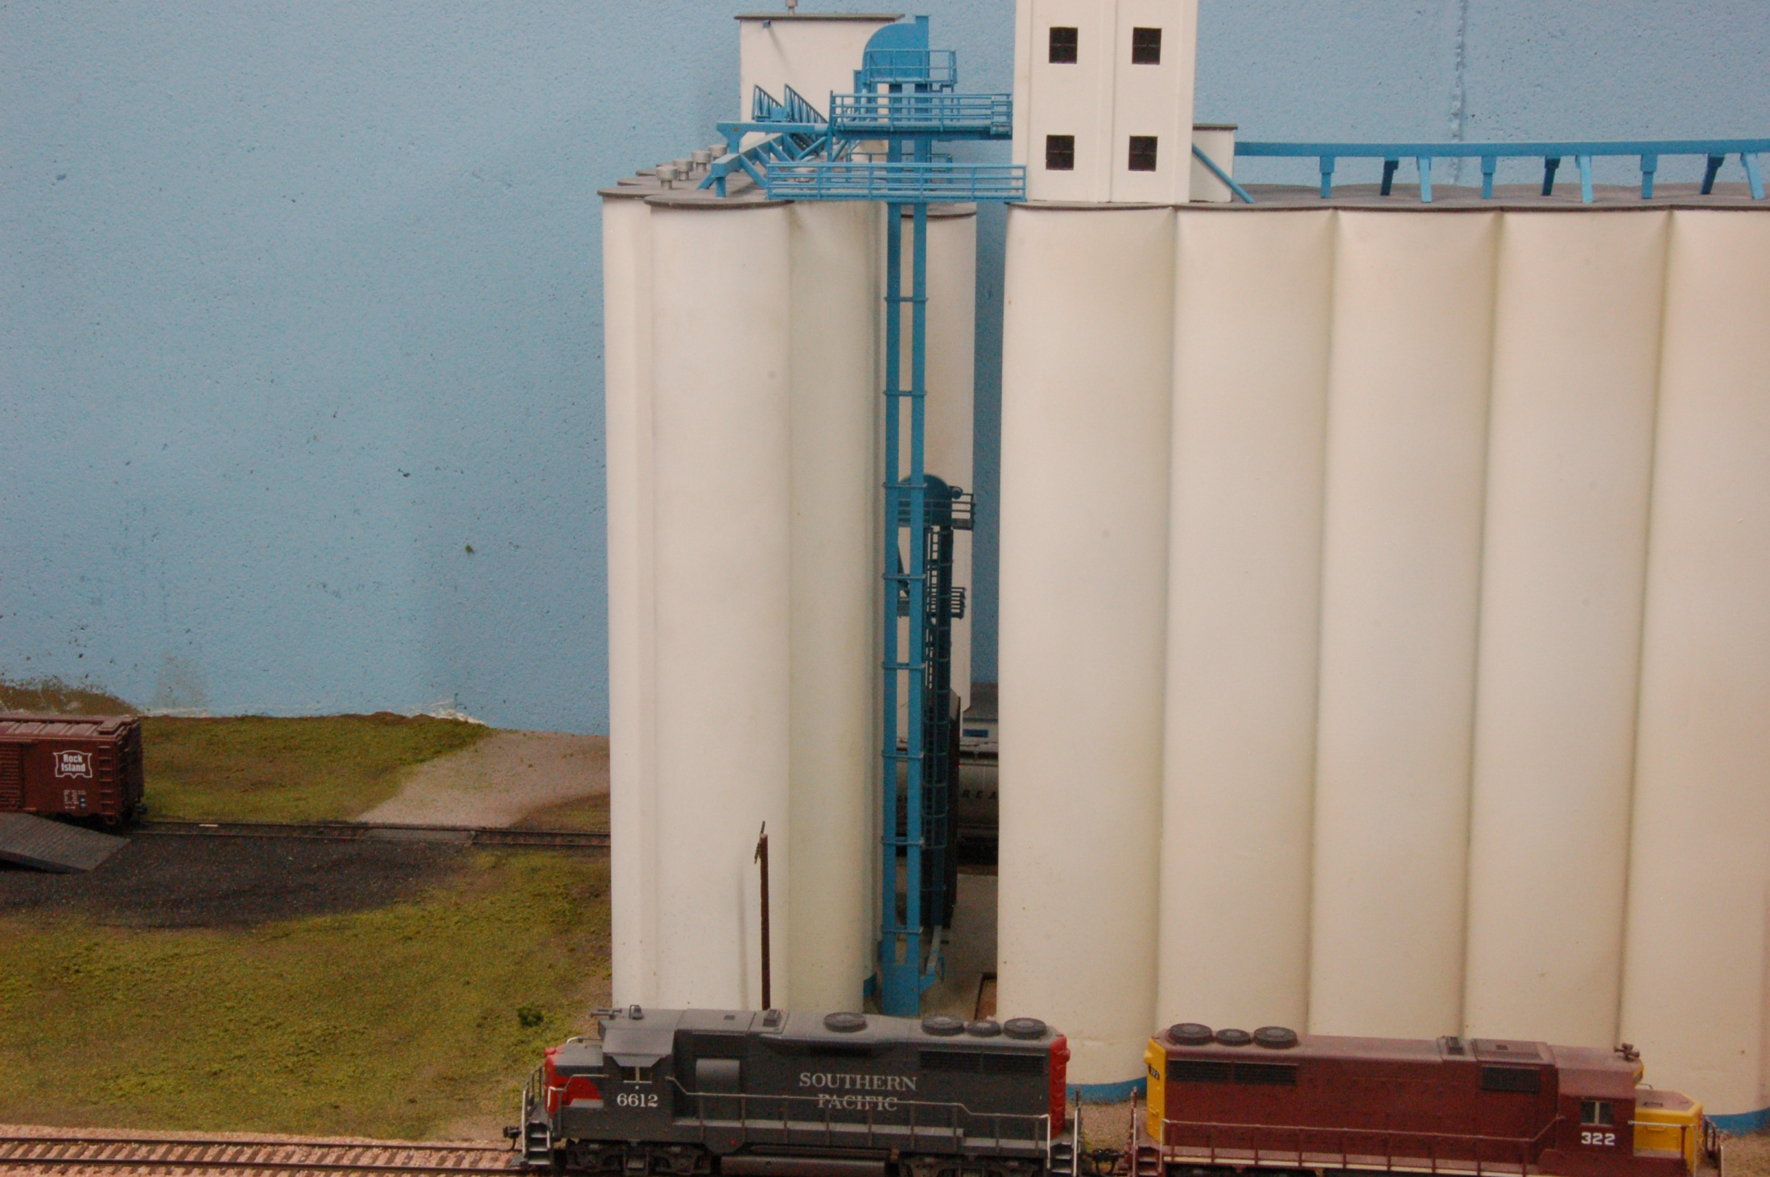
Farmers Union CO-OP
Clay Center, Kansas

Slide 40
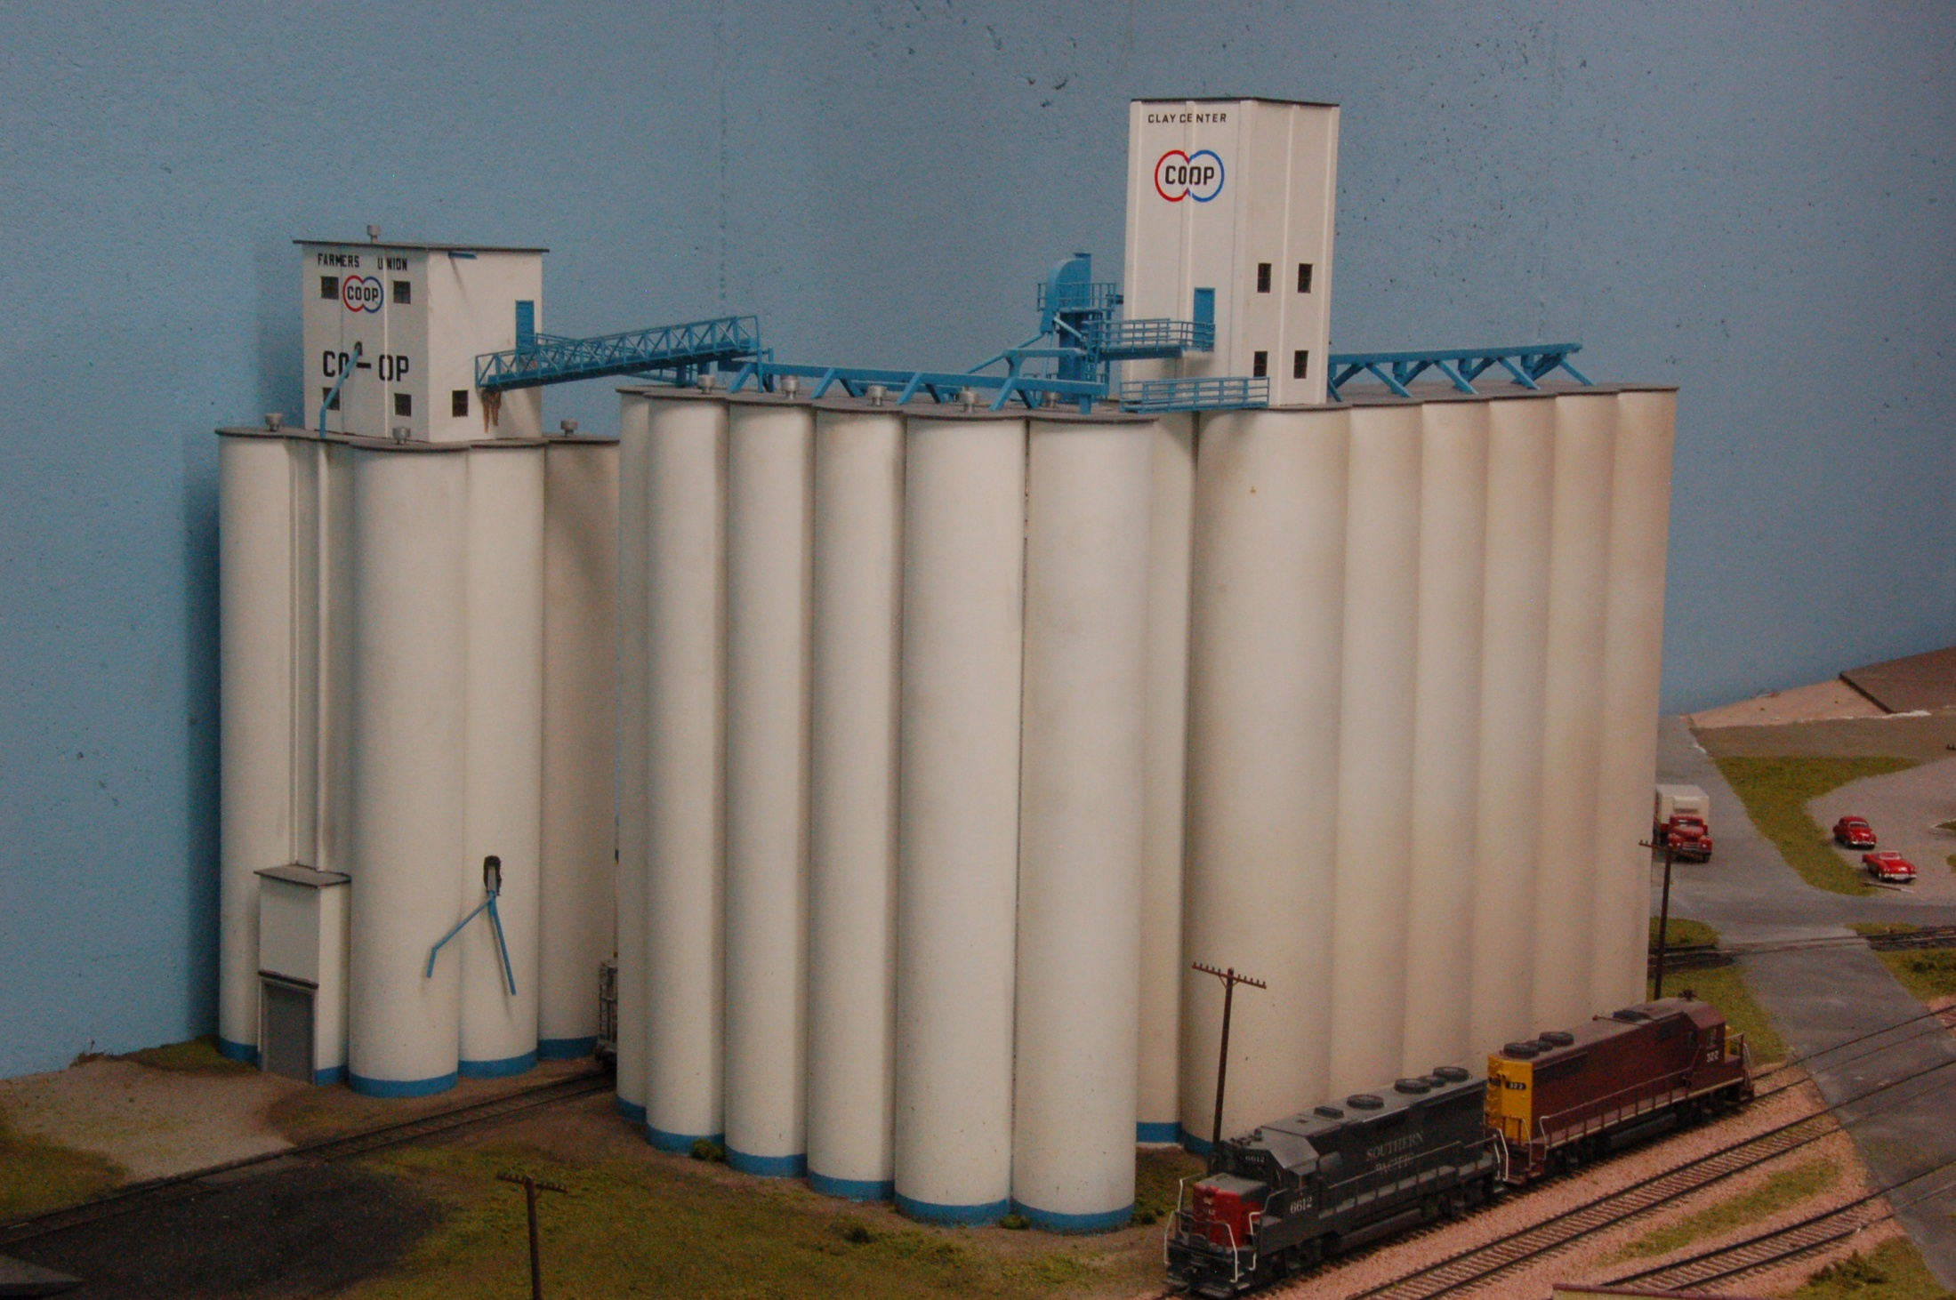
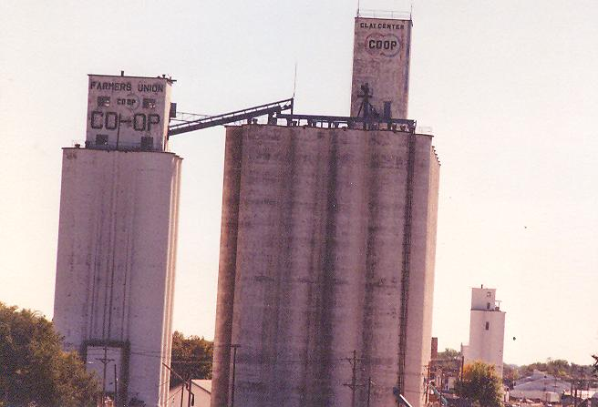
25’ Head house
“Prototype”
84’ Silos
95’ Silos
Farmers Union CO-OP
Clay Center, Kansas

Slide 41
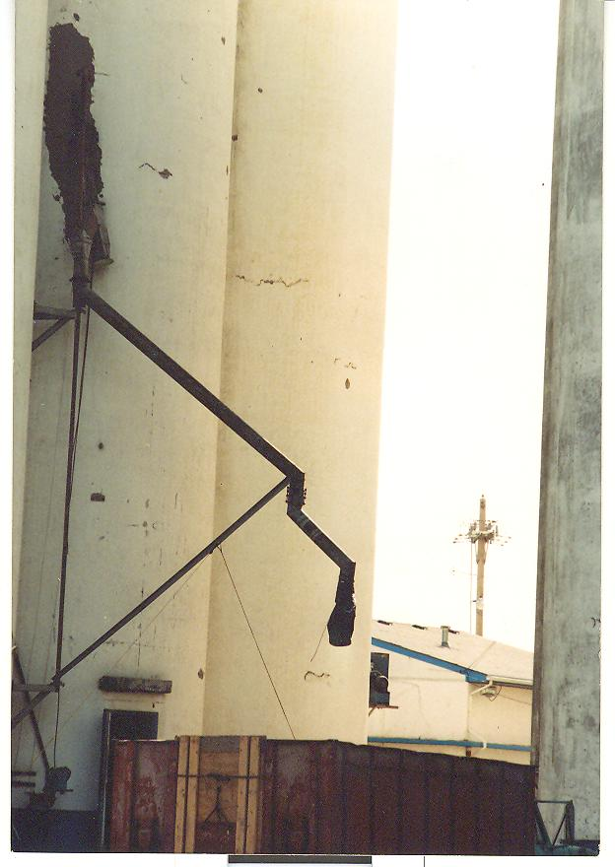
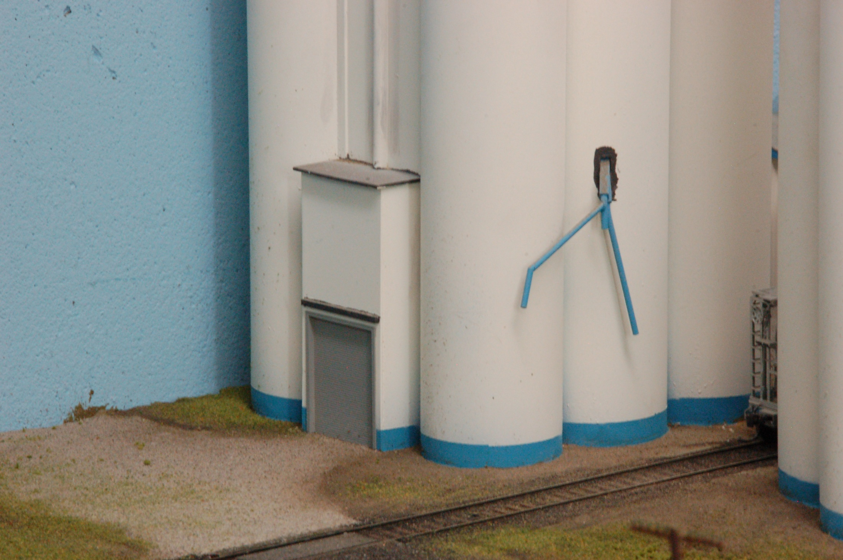
“Prototype”
Farmers Union CO-OP
Clay Center, Kansas

Slide 42
Farmers Union CO-OP
Clay Center, Kansas

Slide 43
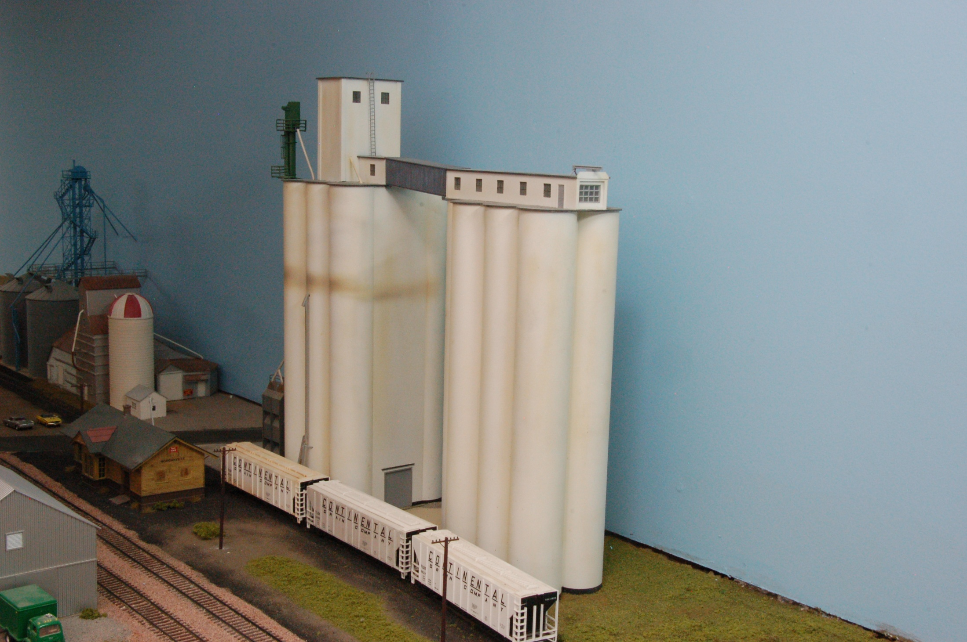
Morganville Elevator
Morganville, Kansas

Slide 44
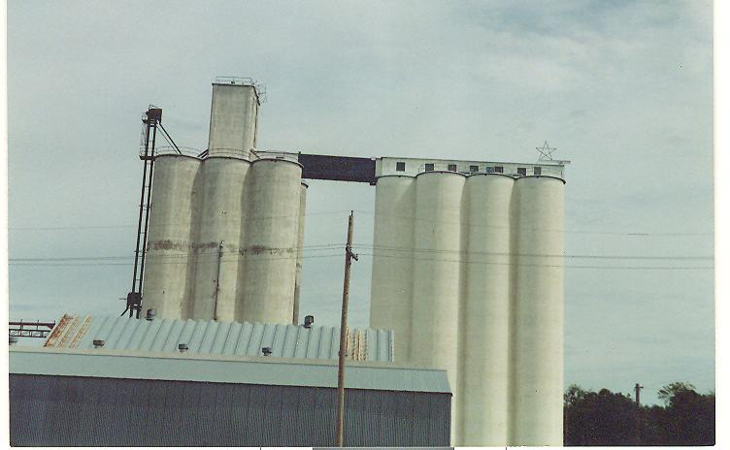
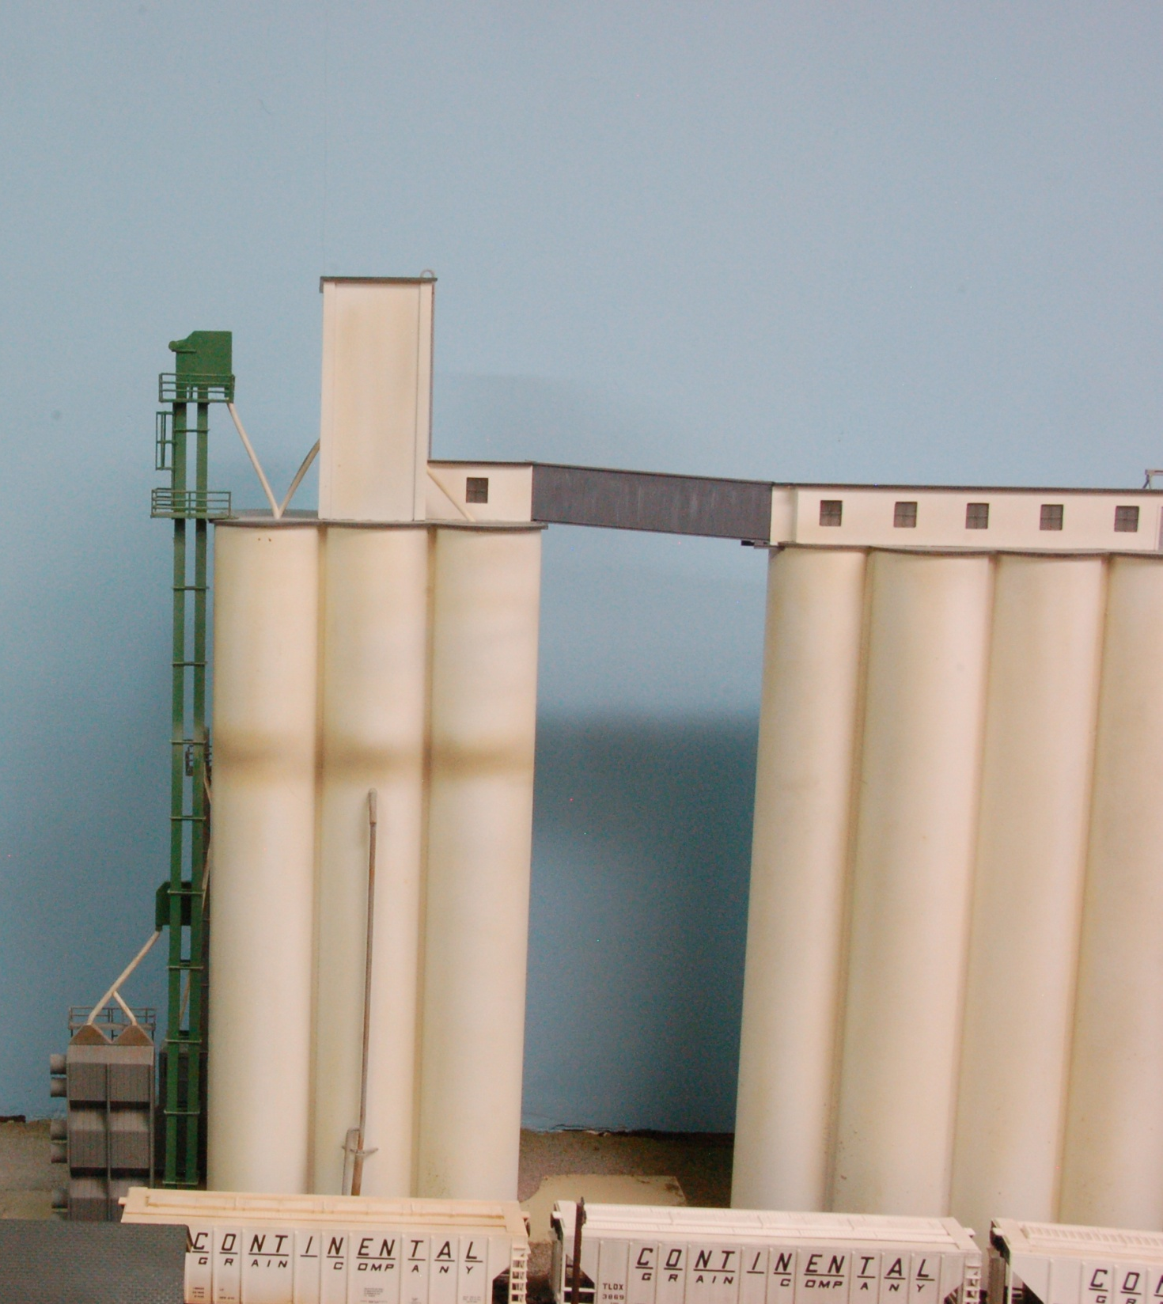
“Prototype”
Morganville Elevator
Morganville, Kansas

Slide 45

Morganville Elevator
Morganville, Kansas

Slide 46


“Prototype”
Dryer
Morganville Elevator
Morganville, Kansas

Slide 47


1 Million Bushel Capacity
25’ Head House
Silos … 3 groups @ 95’
“Prototype”
Clifton CO-OP
Clifton, Kansas

Slide 48


“Prototype”
Dryer
Clifton CO-OP
Clifton, Kansas

Slide 49

Clifton CO-OP
Clifton, Kansas

Slide 50


3.5 Million Bushel Capacity
29’ Head house
Silos 80’
Silos 88’
“Prototype”
United Grain
Belleville, Kansas

Slide 51


“Prototype”
United Grain
Belleville, Kansas

Slide 52


“Prototype”
Hall Elevator
Belleville, Kansas

Slide 53
Where does the grain go?
Where does the grain go?

Slide 54

Elevator “A” … ATSF
2 large storage units
Aggregate Storage 6,283,500 bu
Dumper/Track Shed
Drier House

Slide 55


Slide 56


Slide 57
Constructing My Model
Constructing My Model

Slide 58


Slide 59


Slide 60


Slide 61


Slide 62


Slide 63


Slide 64


Slide 65

Elevators and Feed Mills
on the Kansas Division
of the Rock Island
Part II
Thank You,
Ken Jenkins

