Slide 1

How I Built Elevators
and Feed Mills
on the Kansas Division
of the Rock Island
Part I
Small Rural Wood & Metal Silo Elevators
by Ken Jenkins

Slide 2
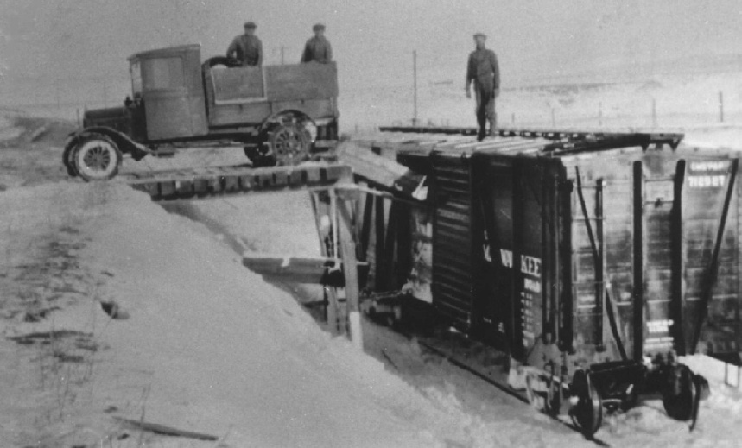
A Little History
Before Elevators
Before Elevators

Slide 3
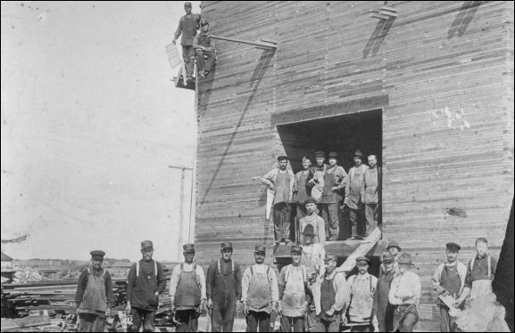
First elevators built in rural areas were generally of wood construction.
There are either:
1) Cribbed Construction
or
2) Studded/Frame Construction
(don’t confuse Cribbed Construction with a Corn Crib)
A Little History
Cribbed Construction

Slide 4
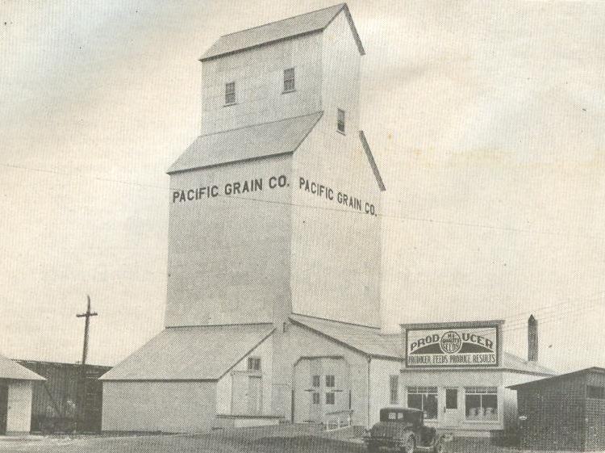
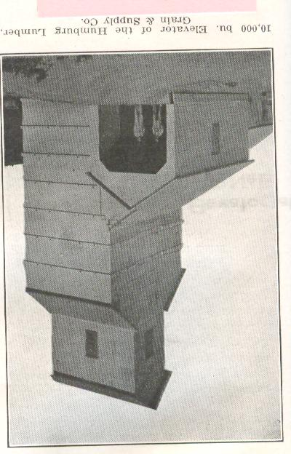
Cribbing is strong …
not requiring extra stiffeners
Note the Horizontal Reinforcement & Tension Membranes
35,000 Bushels
“Cribbed Construction”
10,000 Bushels
“Studded Construction”
Elevator Construction
Elevator Construction

Slide 5
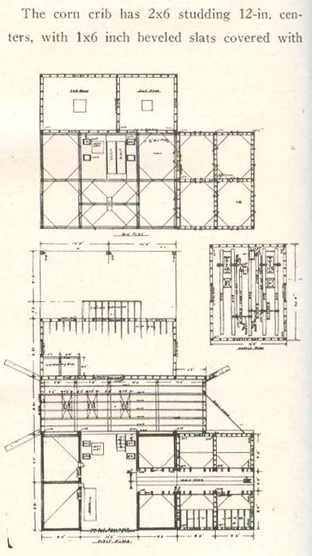
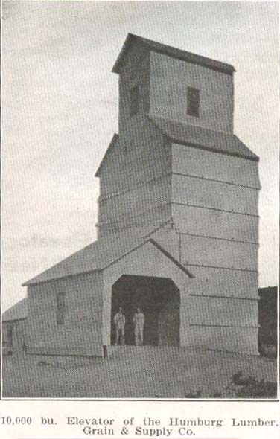
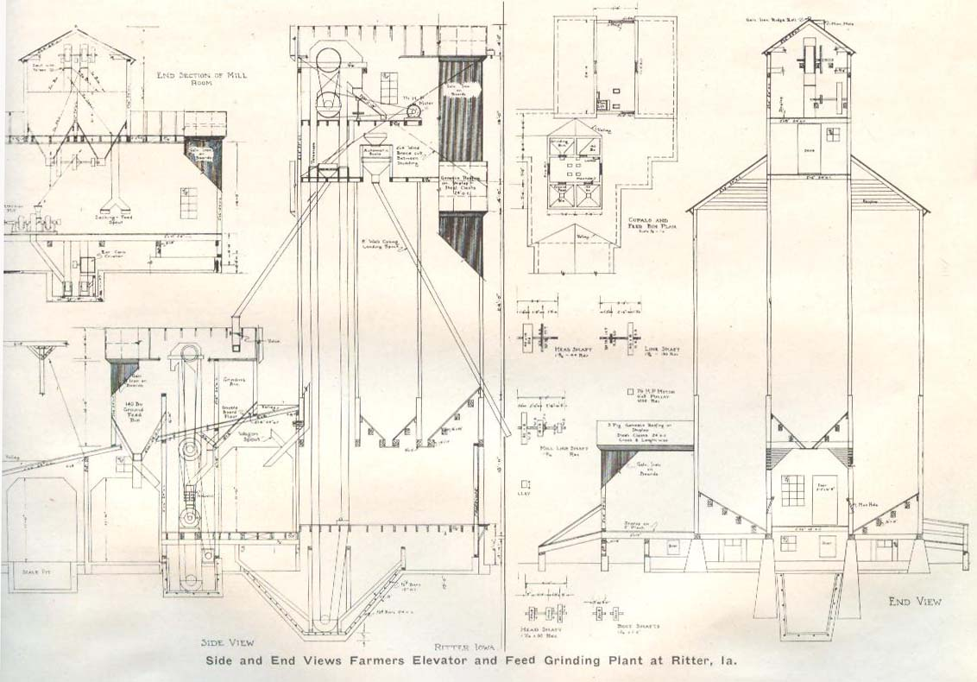
Bins
Reinforcement Timbers
w/through bolts
Upper Plan
Head House
Plan
Elongated
Section
Cross
Section
Studded
Elevator Construction
Studded
Elevator Construction
Lower Plan

Slide 6
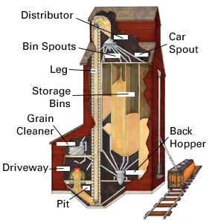
Operation
drawing source … internet
Operation

Slide 7
Elevators were designed as “Capacity in Bushels”
from 10,000 Bushels
to 13,000,000 Bushels.
1 bushel is 1.25 cubic feet volume
Grain weights 35 to 60 lbs./bushel
corn & wheat approx. 60 lbs./bushel
1 bushel is approx. 9 gallons
Grain Weight at 13% to 15%
Oats 38 lbs./bushel 2,632 bul.
Corn 56 lbs./bushel 1,785 bul.
Milo 56 lbs./bushel 1,785 bul.
Wheat 60 lbs./bushel 1,666 bul.
Soybean 60 lbs./bushel 1,666 bul.
40 ft. 50 ton Box Car XM 3,837 cu.ft.
Facts
Facts

Slide 8
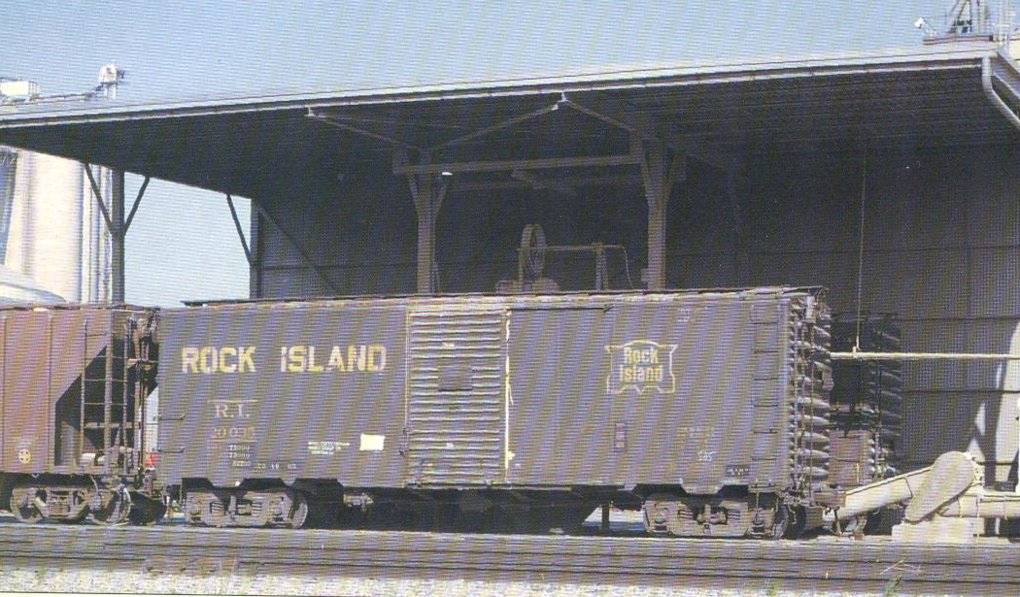
Sealed for Delivery
Sealed for Delivery

Slide 9
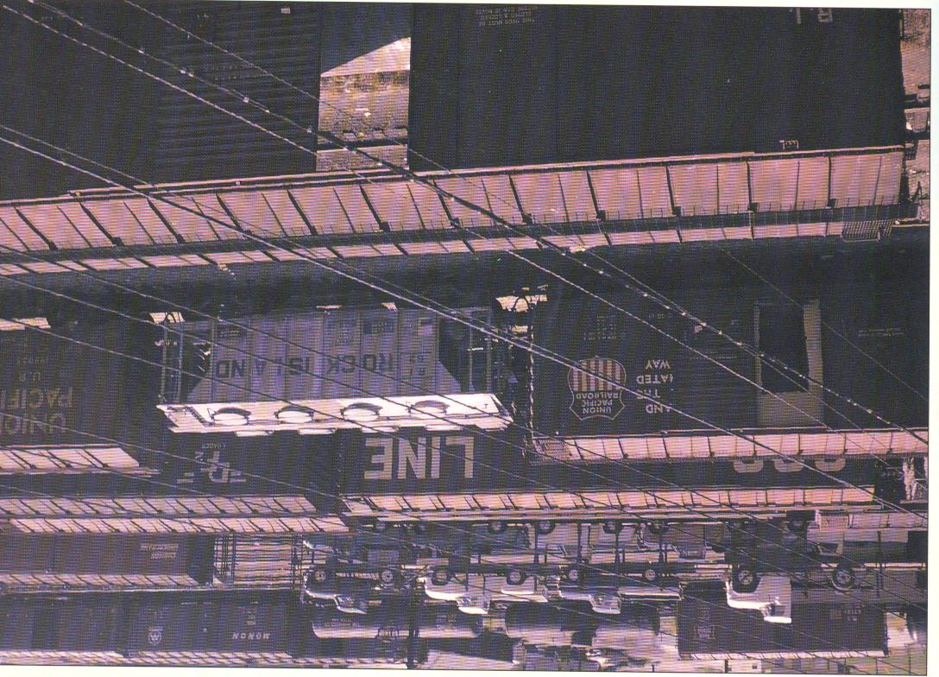
After Unloading
After Unloading

Slide 10
Elevators were located approximately
7 miles apart …
because a 14 mile buggy/wagon trip …
to and from …
Facts
Facts

Slide 11
a 40 foot box car
loaded 5 feet deep . . .
about 1,400 bushels
Facts
Facts

Slide 12
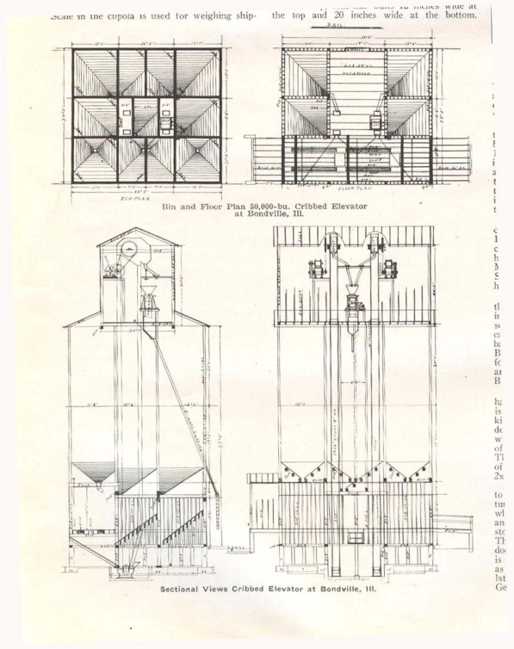
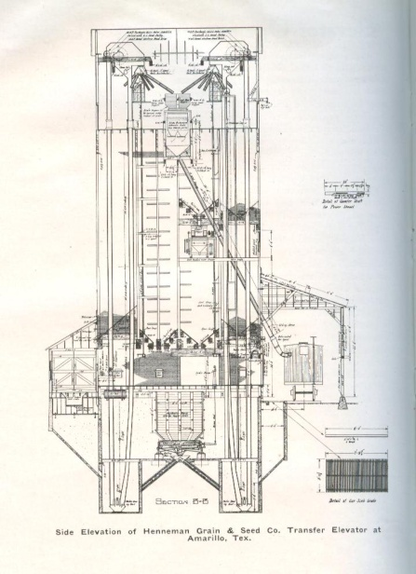
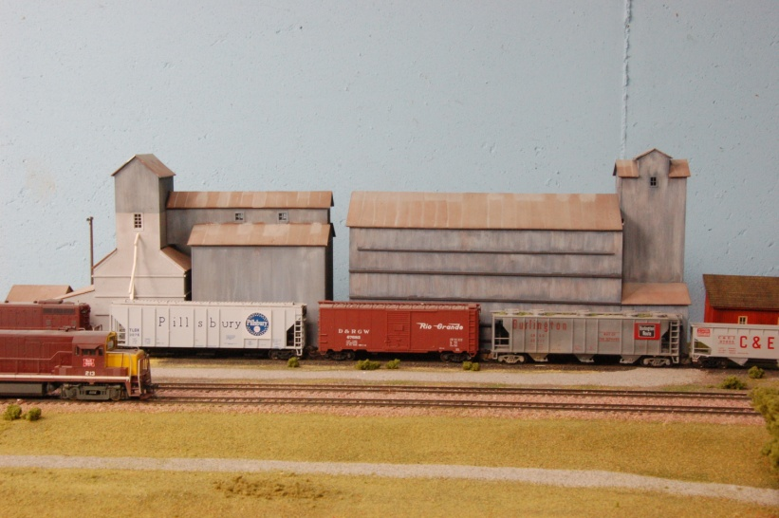
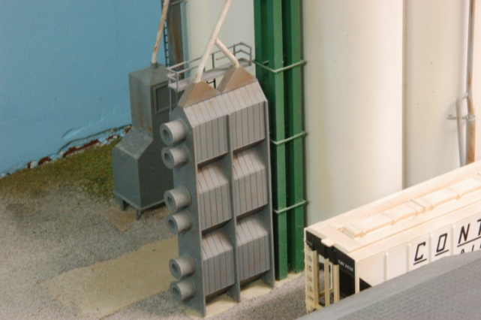
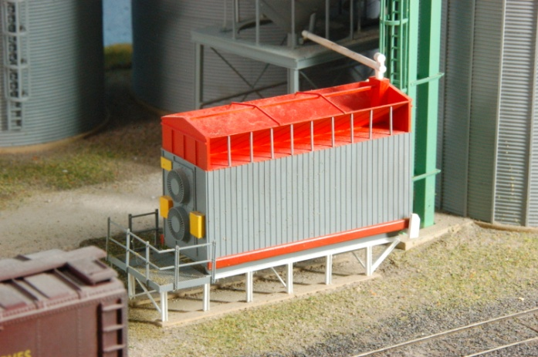
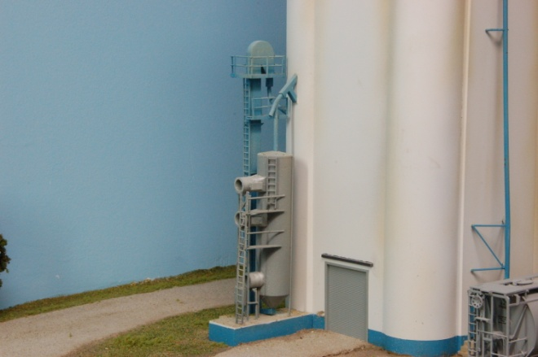
Separate Bins
Moisture Content is real important in Grain
Grain dryers occur at each elevator.
Plan Views
Train
Car
Load &
Unload
Sections
Grain Elevators
Dryers …
Grain Elevators

Slide 13
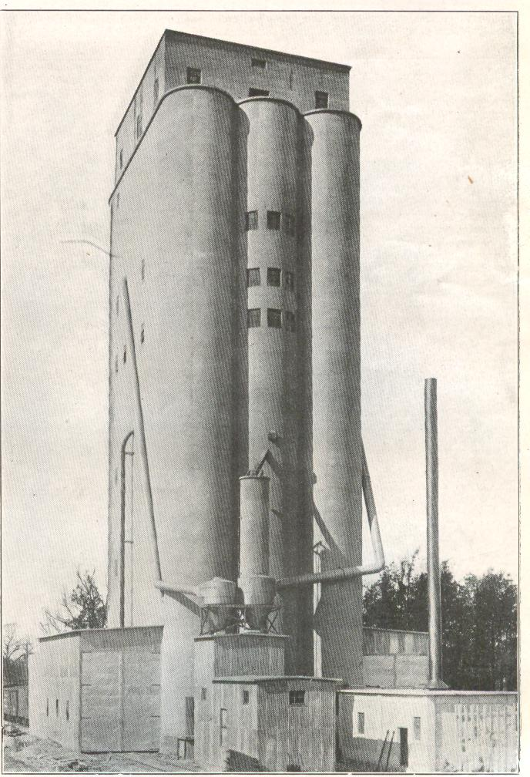
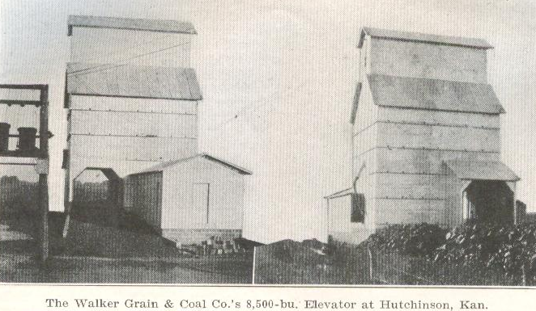
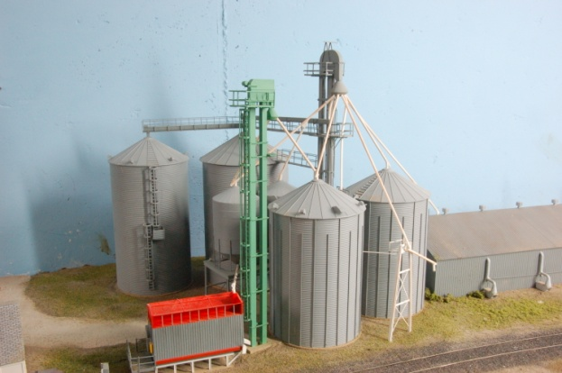
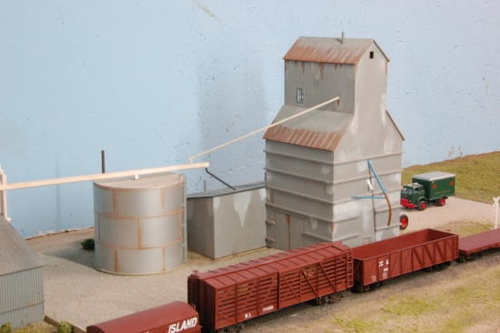
Almost all Elevators have a water resistant siding …
then “Iron Cladding”
“Corrugated Galvanized Steel”
originally wood lap clapboard siding …
Grain Elevators
My Model Examples
Agenda, Kansas
Grain Elevators

Slide 14
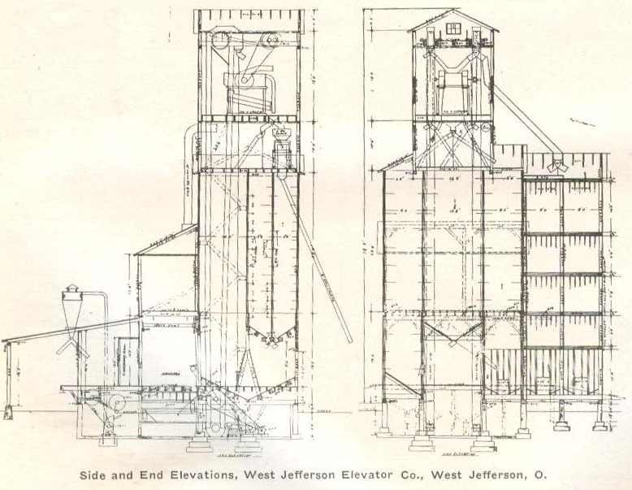

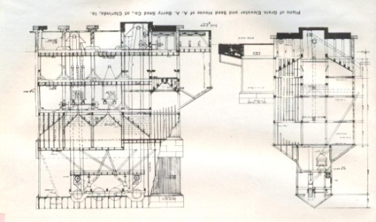
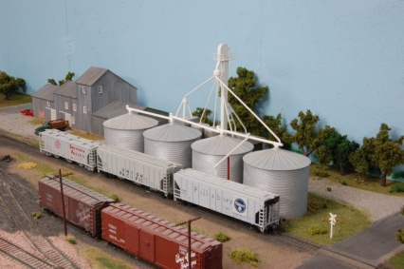
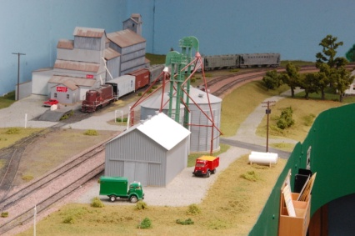
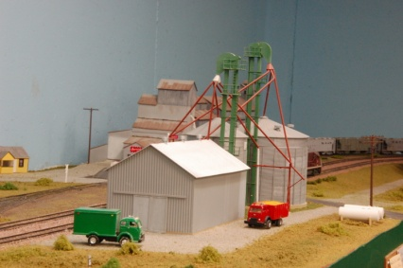
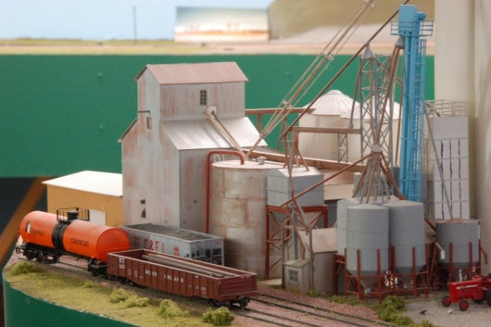
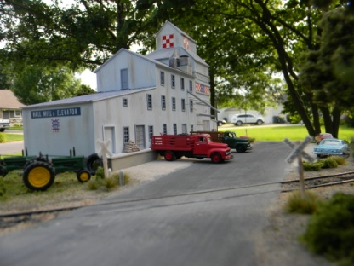
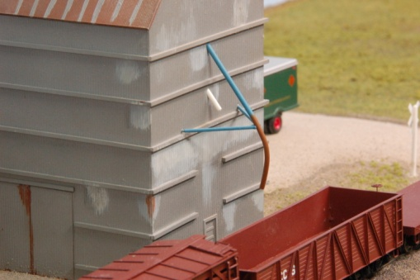
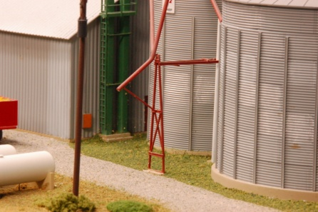
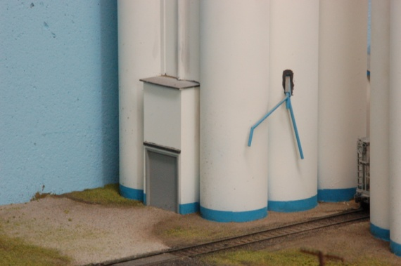
Unloading and Loading
Trucks to Train Cars (Rural Elevators)
Train Cars to Train Cars
or both
all my models … Truck in … Train out
Grain Elevators
Grain Elevators
Delivery Pipes for Loading

Slide 15
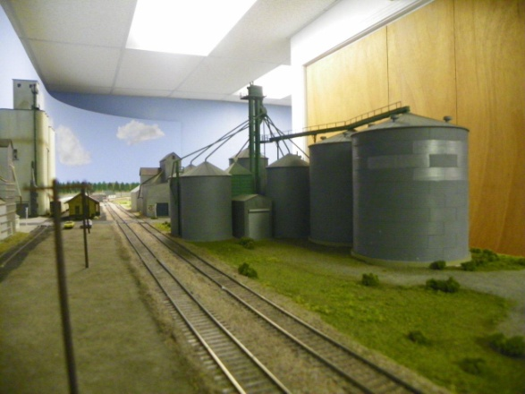
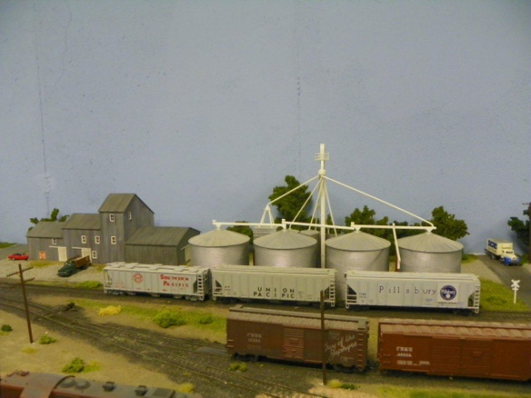
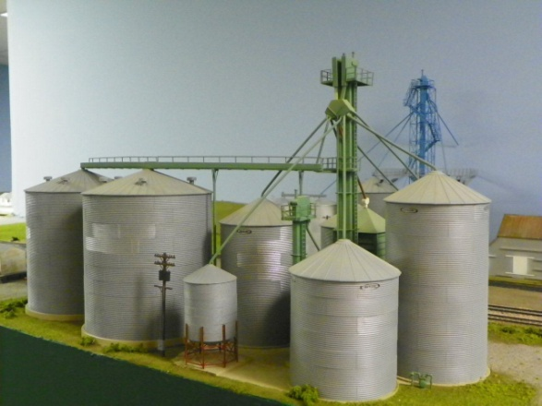
Multiple Bins
allows storage of
Bins
a) Different Grains
Grades of Grain … “Different Moisture Contents”
c) Wheat and barley on the basis of protein content
Head House
Plan View
My models handled:
wheat
corn
milo
Grain Elevators
Bins
Grain Elevators
Plan View

Slide 16
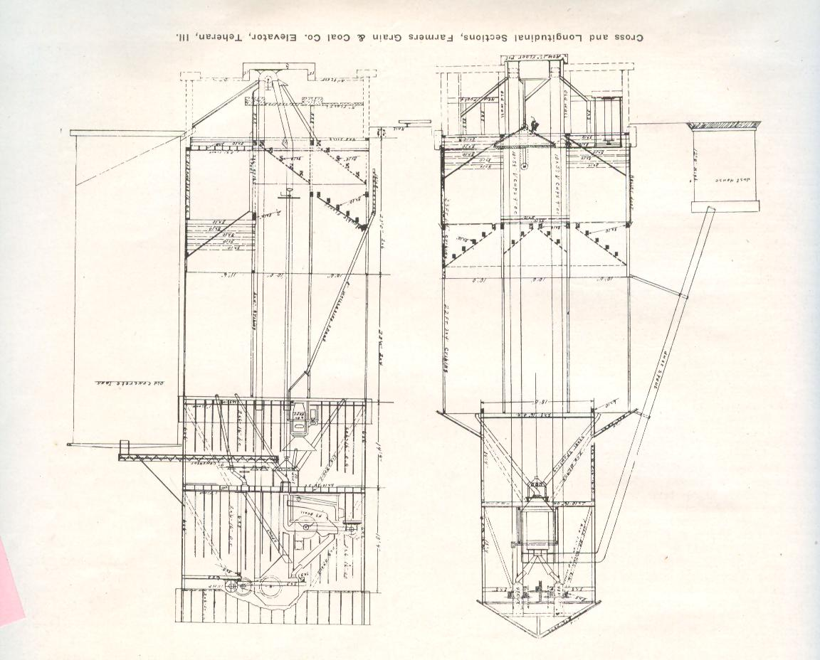
Elevator Heads
Elevator Heads
Elevator Heads
Mixer
Bins
Dust Spout
Loading
Delivery Pipe
Vertical Legs
Dust
Collector
Cross Section
Longitudinal Section

Slide 17
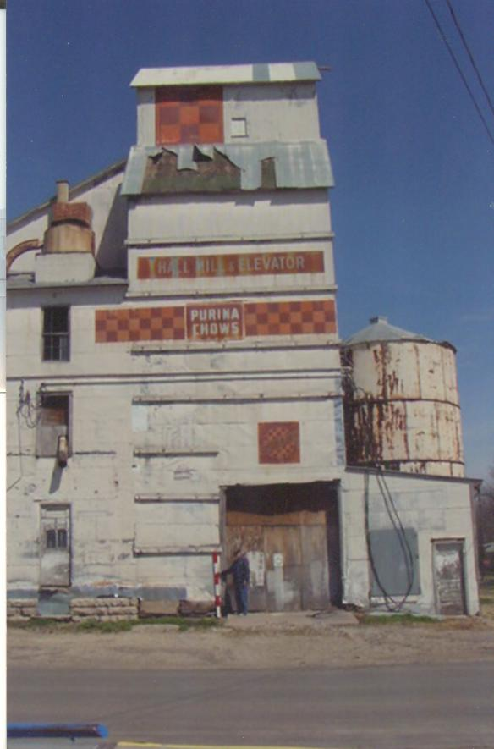
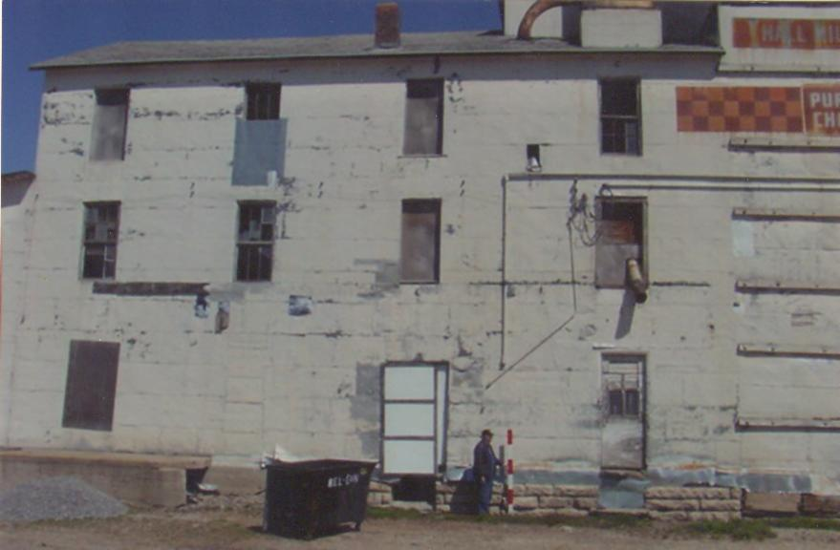
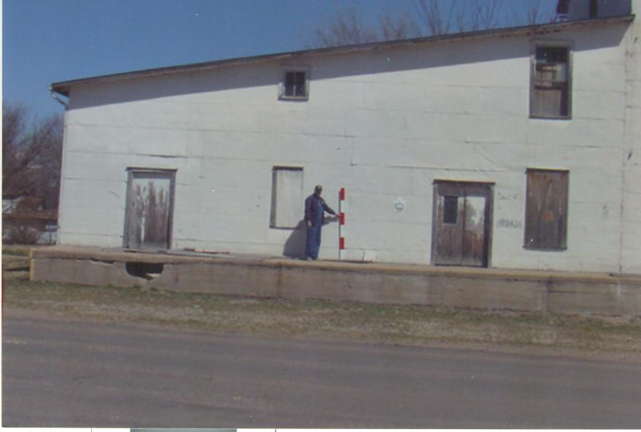
First
First
Photo and measure.

Slide 18
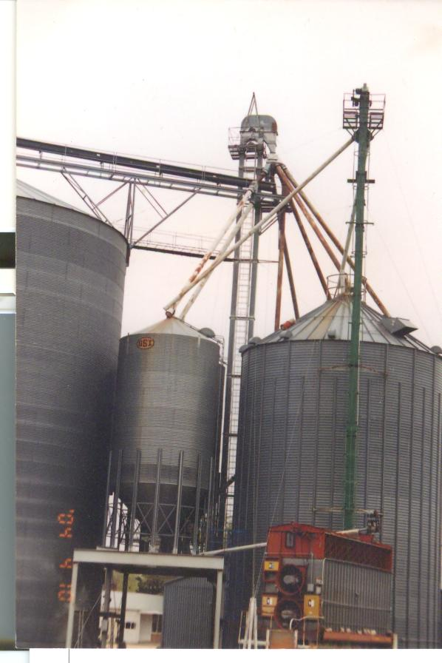
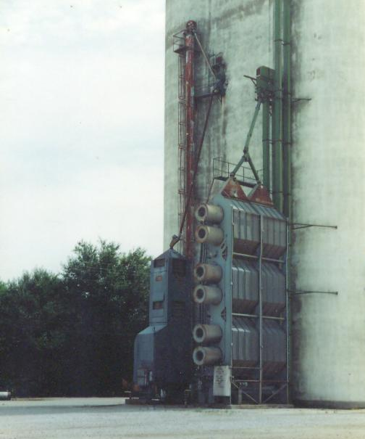
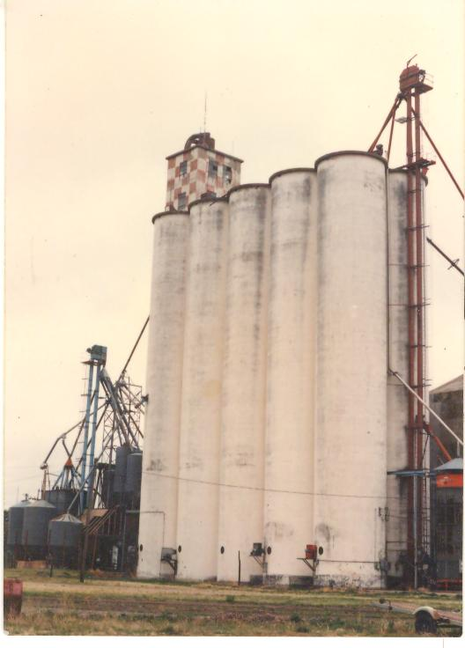
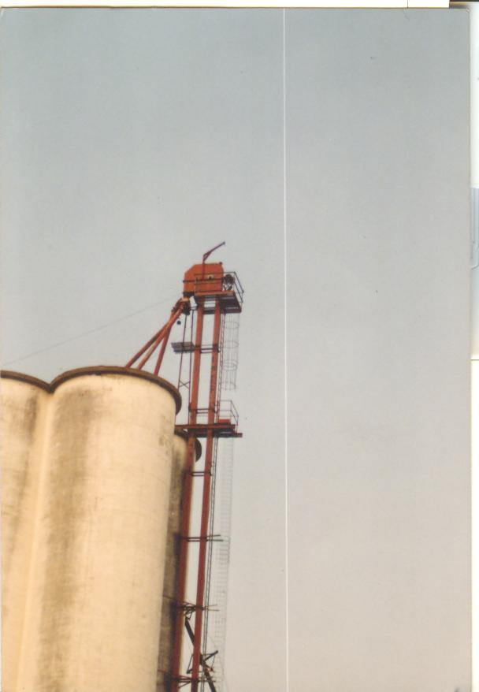
First
First
Elevator Head
Photo Details
Dryer

Slide 19
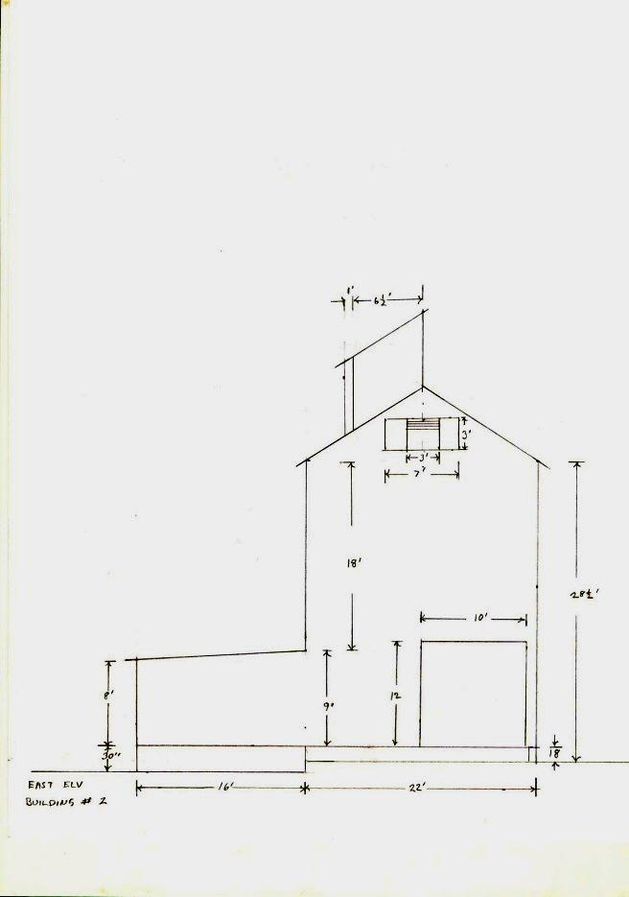
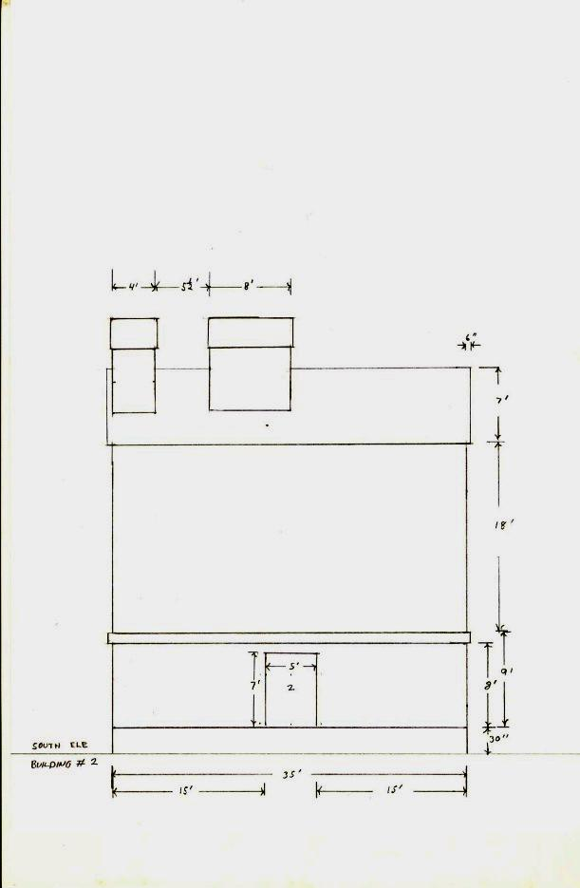
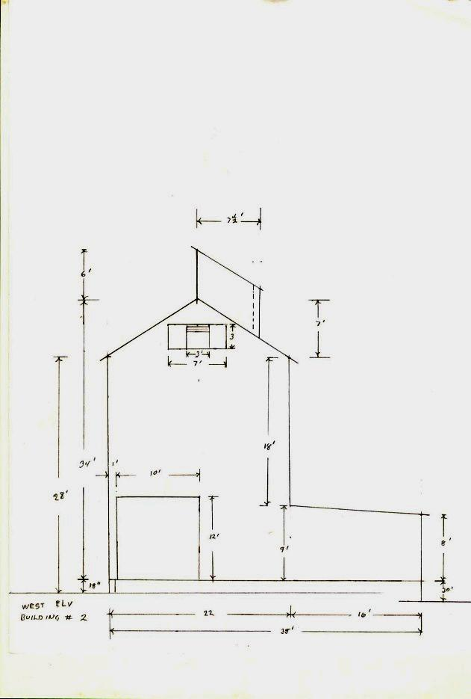
Second
Second
Use prepainted
dimensional stick to
establish photo scale.
I do drawings.
Exterior Dimensional Elevations

Slide 21
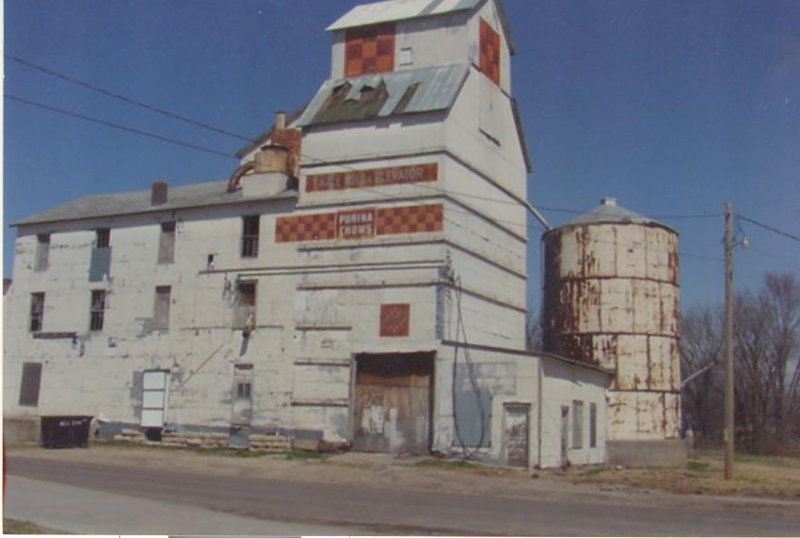
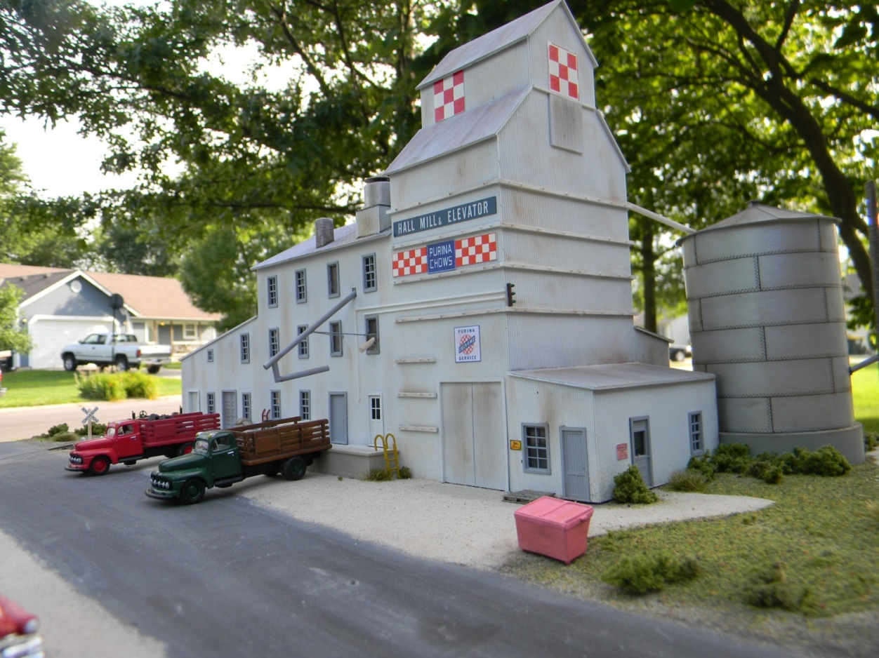
Third
Third
Silo scratchbuilt
Build using drawings and photos.
Delivery door
Model all scratchbuilt
Hall Mill & Elevator
Hall Mill & Elevator
a feed store …
grinding and mixing
Belleville, Kansas

Slide 22
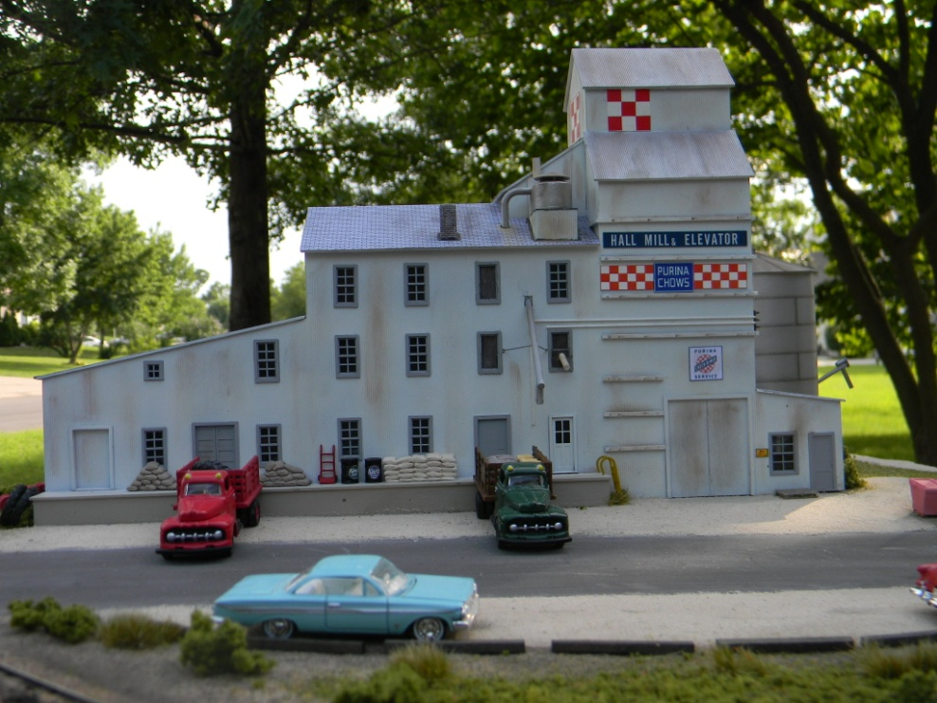
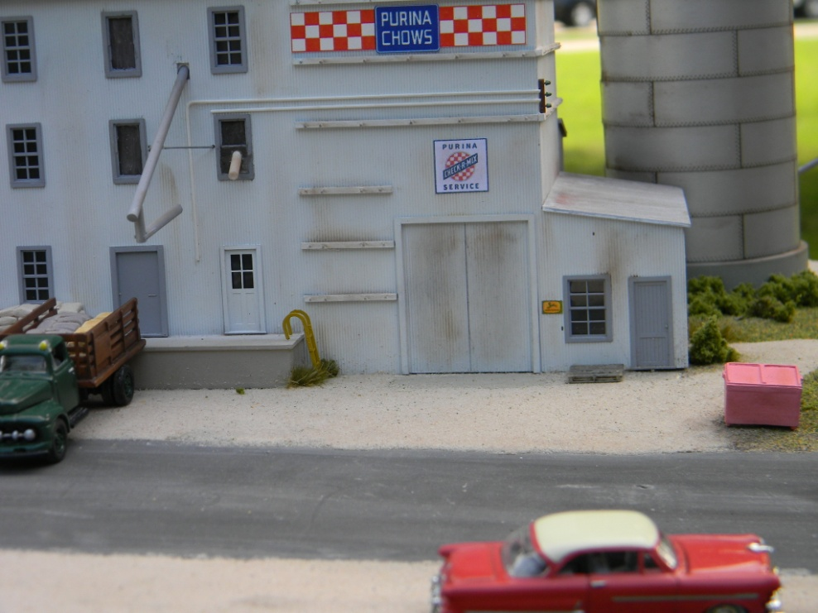
Electrical Service
Delivery Pipes
Hall Mill & Elevator
Hall Mill & Elevator

Slide 23
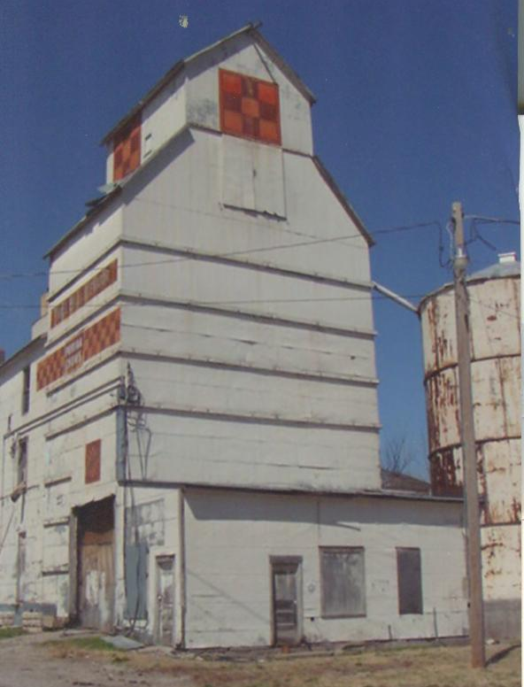
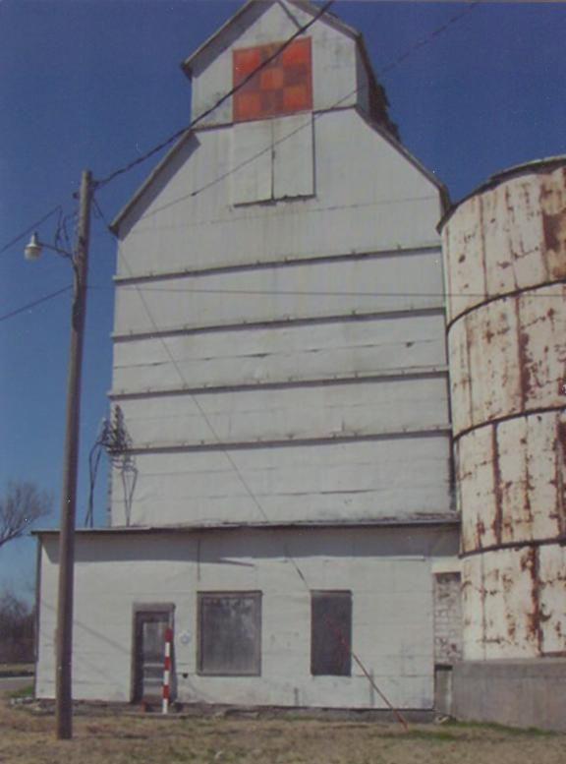

Hall Mill & Elevator
Hall Mill & Elevator

Slide 24

Hall Mill & Elevator
Hall Mill & Elevator

Slide 25


scratchbuilt from PVC
Molasses tank
Hall Mill & Elevator
Hall Mill & Elevator

Slide 26





dust
collector
black
paint to represent tar seam
Hall Mill & Elevator
Hall Mill & Elevtor
Belleville, Kansas

Slide 27



Hall Mill & Elevator
Hall Mill & Elevator

Slide 28

unloading truck door
outgoing dock
Supersweet Feed
Supersweet Seed & Feed
Riley, Kansas

Slide 29

Head House
Head House
Horizontal
Conveyor
Delivery Pipe
Supersweet Seed & Feed
Supersweet Seed & Feed
Riley, Kansas

Slide 30

Horizontal Conveyor
Inside
Head House
Delivery Pipe
Office

Slide 31

Original Elevator
Later
Addition
Puring Feed Mill
Purina Feed Mill
Clay Center, Kansas

Slide 32

Original 1800’s Elevator
6 compartment bin for delivery
4 compartment bin for delivery
Bin
Cattle Feed
Scale House

Slide 33

Vertical Leg
Horizontal Leg
Distribution
seams in panels were plugged with tar

Slide 34


Slide 35


Slide 36

Old
Original
Elevator

Slide 37

Valley Feed
Valley Feed
Morganville, Kansas

Slide 38
1887
1887
Valley Feed
Valley Feed
Morganville, Kansas
Morganville, Kansas

Slide 39

Grain Dryer

Slide 40

Morganville Coop (1969)
Moganville Coop (1969)
Morganville, Kansas
Morganville, Kansas

Slide 41

Delivery Pipe
for Hoppers
Delivery Pipe
for Box Cars
Morganville Coop (1969)
Moganville Coop (1969)
Morganville, Kansas
Morganville, Kansas

Slide 42


Slide 43

Truck Delivery

Slide 44

16 Bins
Shippers Coop Feed
Shippers Coop Feed
Clifton, Kansas

Slide 45


Slide 46


Slide 47

Studded
Construction
Truck Delivery
Agenda Coop Elevator
Agenda Coop Elevator
Agenda, Kansas

Slide 48


Slide 49

Screw delivery pipe
Horizontal Bins
Truck Loading
dryers
Agenda Coop Elevator
Agenda Coop Elevator
Agenda, Kansas
All Hopper Car Operation

Slide 50

dry bulk fertilizer

Slide 51


Slide 52


pneumatic control orifice

Slide 53


Dryer …

Slide 54

hopper car delivery
circulation for dryers

Slide 55


Slide 56

Horizontal Feed Conveyor

Slide 57

Brown Burton Grain
Brown Burton Grain
Manhattan, Kansas

Slide 58


Slide 59



Slide 60

Dryers
Supwer Sweet Annex … Grain
Super Sweet Annex … Grain
Riley, Kansas

Slide 61


Slide 62


Slide 63

Truck Delivery

Slide 64


Slide 65

Elevators and Feed Mills
on the Kansas Division
of the Rock Island
Thank You,
Ken Jenkins

